Slide 2
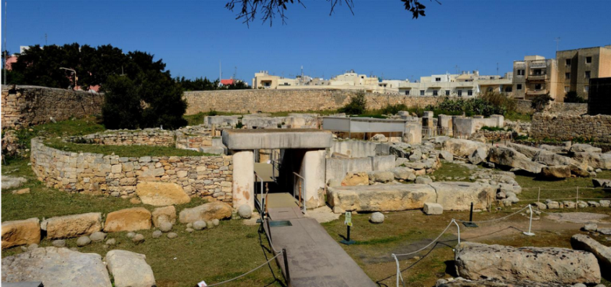
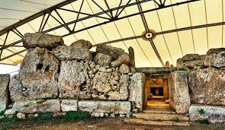
Financial Instruments as Agents of Regional Development: Lessons Learnt and Future Potential
Anton Theuma, Ph.D.
CEO Paragon Europe

Slide 3
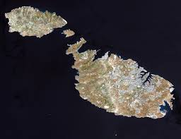
Who we are
Added value partner in EU affairs and projects
Malta and Brussels offices
Expertise in different areas including:
Capacity Building and Technical Assistance
Sustainable Development and Environment
ICT, Innovation & Entrepreneurship
Education and Training
Tourism & Cultural Heritage

Slide 4
Financial Instruments:
Some Reflections on 2007- 2013

Slide 5
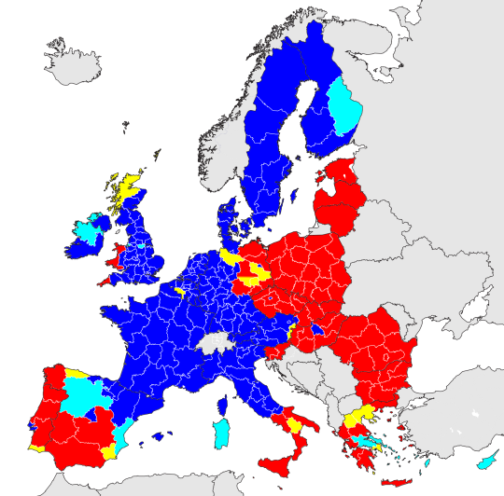
Financial Instruments 2007 - 2013
OBJECTIVES of FIs in promoting Regional Development
Address market imperfections in the availability of capital
Improve the quality of investments
Notes:
lopment

Slide 6
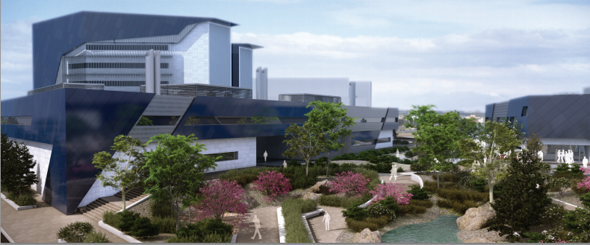
Financial Instruments 2007-2013
FIs potential lies:
FIs are sustainable
Generate quality projects
More efficient use of public funds
Notes:
Sustainable – because funds are recycled to be spent again in the region
Generate better quality projects – funds have to be repaid, and commercial expertise was engaged to assess project
More Efficient use of public funds – because private sector monies was utilized to supplement public spending.

Slide 7
Financial Instruments 2007 - 2013
Some results*:
941 co-financed FIs
69 holding funds and 872 specific funds
the 941 co-financed FIs were aimed as follows:
91% business development
6% at urban development
3% at energy efficiency and renewables
*European Commission Summary Report 2014 in Wishlade, F and Michie, R (2014) Financial instruments in 2014-20: learning from 2007-13 and adapting to the new environment “Challenges for the New Cohesion Policy 2014-20: an Academic and Policy Debate”, 2nd joint EU Cohesion Policy conference, Riga, 4-6 February 2014

Slide 8
Lessons Learnt
The need for capacity building to identify, develop and fund SME projects
FIs need to reflect the territory in which they are to be implemented
More co-ordination among stakeholders on territory is required
Flexibility to adapt to the developing socio-economic and political environments
Need for the right skill-set for persons managing funds

Slide 9
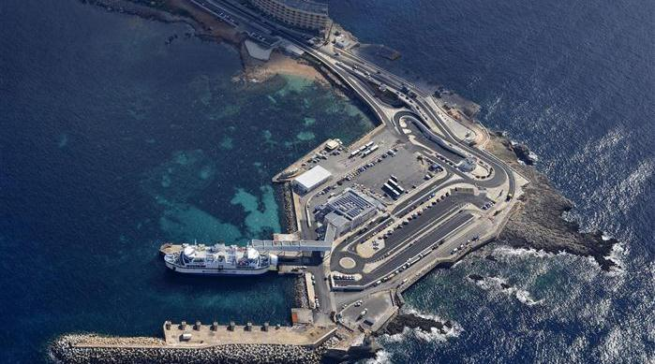
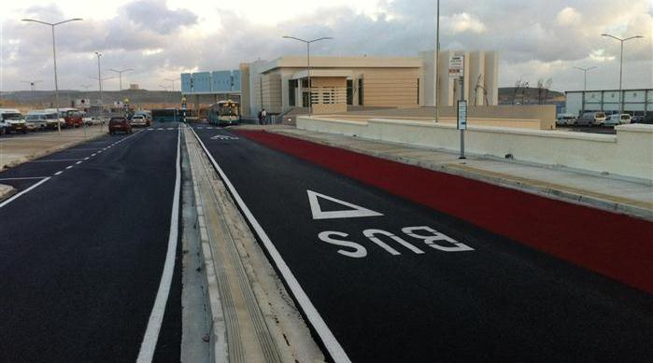
Challenges
FINANCIAL INSTRUMENTS
MEANS of DEVELOPMENT
OPTIMISATION
MAXIMISATION VALORISATION
and

Slide 10
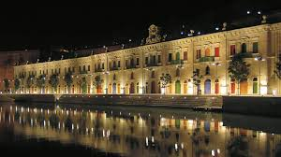
Future Perspectives FIs - Strategy
Harness best practices
Outreach not only to neighbouring regions
Branding of R&I excellence
Useful skills sets

Slide 11
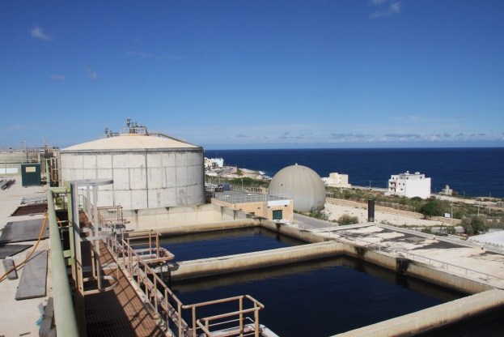
Future Perspectives FIs - Financial
Financial investment to match more the smart specialisation strategies of the region
Better absorption of ERDF and complementary funds
Exporting innovative technologies
Financial ecosytem put in place

Slide 12
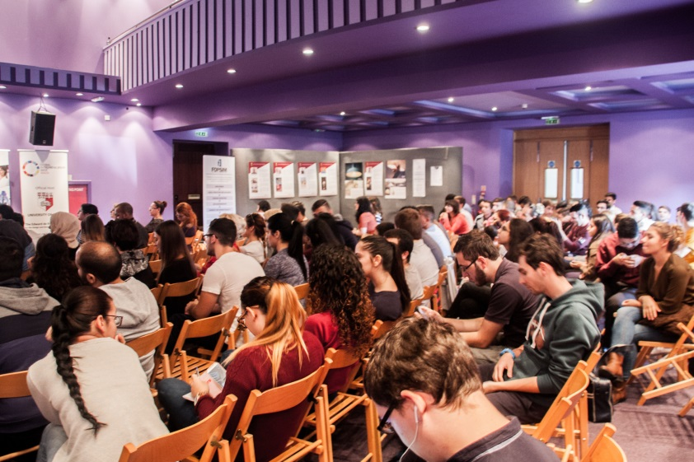
Future Perspectives FIs - Economic
Virtuous vs vicious economic outlooks
R&I vs entrepreneurship
Macro vs micro
Free market vs cohesion

Slide 13
Concluding Thoughts
“What gets measured gets improved”
“If you want something new, you have to stop doing something old”
“Results are gained by exploiting opportunities, not by solving problems”
Peter Drucker, Management Consultant

Slide 14
Conclusion
Working with Paragon Europe means organisations can access the experience, expertise and excellence of an international EU affairs company performing challenging, complex work with the responsiveness and reputation of a trusted local business partner
Paragon Europe prides itself in having a multidisciplinary, international and multilingual team who are experts in their fields and work to achieve the best project results for Paragon, its affiliates and their clients

Slide 15
anton.theuma@paragoneurope.eu

