Slide 1
Managing Business Angel Networks

Slide 2
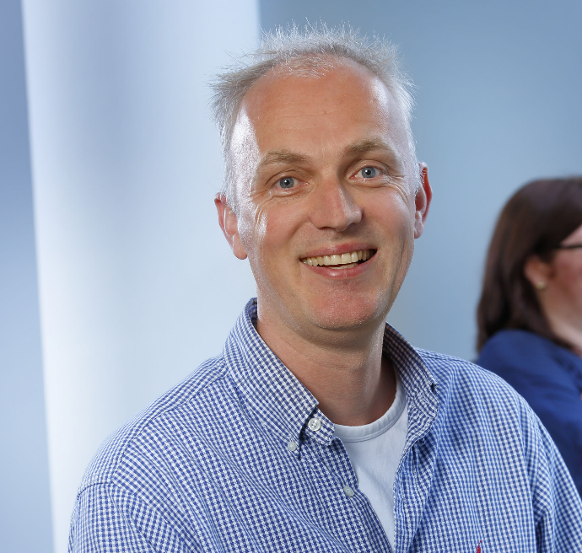
About me
Background:
Deloitte, Rabobank, Min. Econ Affairs
PPM Oost (VC)
Program manager BA network
Program manager H2020/ Eurostars
Bart Heuts
bart.heuts@oostnv.nl

Slide 3
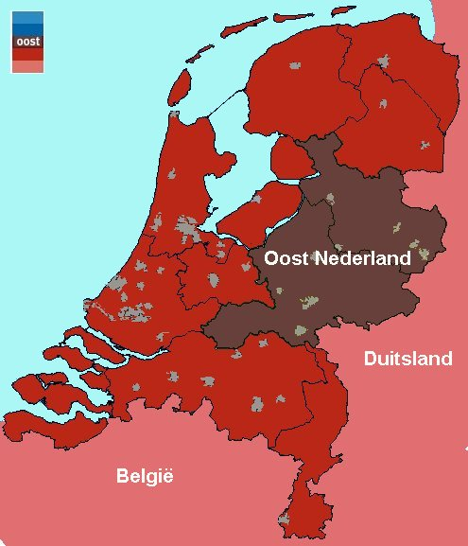
OOST NV – RDA East Netherlands
Development agency and investment agency (VC) in one organisation
Goal: Support and facilitate entrepreneurs in East netherlands
Facilitate them to bring knowledge and innovation to commercial value.
Support in the fields of
Improve conditions for local business location
Building Clusters and consortia
Business development
Internationalisation
Finance (a.o. via Bus Angels)

Slide 4
Business Angel Investing
The setting, the context
Business Angels: what does it mean?
Why needed?
Where to find?
What’s their focus?
How to inform and support, as a RDA, the entrepreneurs?

Slide 5
Life Cycle & Financing
Turnover / Profit
(EARLY)GRWOTH
PRE-SEED
MATURE
DECLINE
SEED
Time

Slide 6
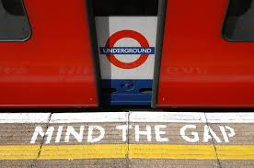

Slide 7
Different “tastes” of Finance
Proof-of
Concept
Product
Design
Product
Development
Production/
sales
“Discovery”
“STW”
Pre-seed
Funding
Seed Funding
Start-up Funding
Expansion/Mezzanine
Customers
Operating Cap.
Own Money
Friends Family Fools
Venture Capital
Subsidies
BusinessAngels
PrivateEquity
Angel Groups
Loans / Banks
Seed Funds
Pre-Seed

Slide 8
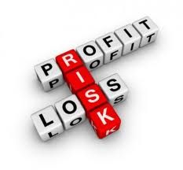
Business Angels…. Real human beings?
Experienced ex-entrepreneurs investing for their own risk & return: risk capital (shareholder) meant for other companies
Active, Social-driven, but always driven by return of investment!
Risk - investors
They bring “CKN”: Capital-Knowledge-Network
50k – 500k, often in “proven” companies!
Angels or Devils in Diguise?
Real investors?

Slide 9
Business Angels: why needed?
Networks: introductions, customers, suppliers, relevant knowledge, partners
Knowledge: coaching en business experience
Capital: make use of different opportunities
“Normal finance” impossible at this stage…
Expensive finance…’sometimes …”last-resort finance...
Balance added value must be positive related to attracting an external shareholder!

Slide 10
Business Angels
Where to find?
Business Angel Netwerks national
BAE (Europe)
Other netwerks (acc – banks, etc)
What do they want to know?
How to get in contact with them?
Chance/ Role for RDA’s to bridge this gap?

Slide 11
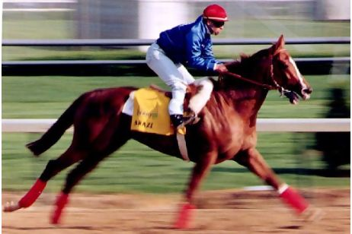
What’s pulls their attraction?
Informal Investment means ➔ INFORMAL is key!
“Do they bet on the Jockey or on the Horse?”
“Is it the Brains or the Luck?”
Not pure science!
Yet some covering key-parameters

Slide 12
Key elements for a Business Angel
Drive of the entrepreneur and/or the team
Clear proposition
Solving a real market problem
scalable
How to earn money
I.P. / advantage or edge
Temporary investment: exit-driven deal
Total proposition: market need - supply
Above all: ….logica!

Slide 13
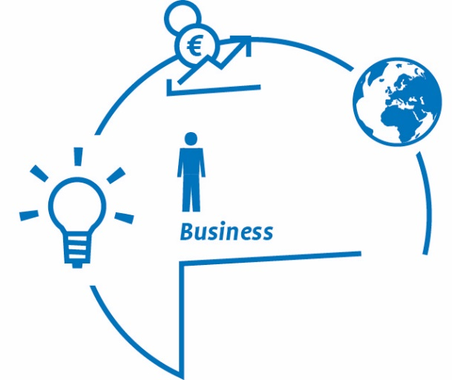
How do we support entrepreneurs at Oost NV?
Many start-ups
Bringing different players together
Make use of our business development
knowledge
Who’s the real entrepreneur?
Common ground to build on?
Strong balanced team
Fun and ability to cope with bad luck
Wants to find solutions!?!
Commercial?
Realisme?!
Open for constant advice and “coaching”?
Willingness to share?

Slide 14
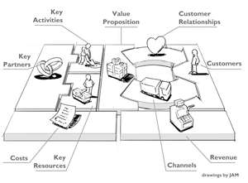
Essential before pitching
A thorough businessplan
A “logical” business model
Realistic financial plan
Elevator pitch in 2 minutes
Business Model Canvas
Good understanding and mitigation of risks

Slide 15
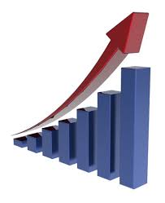
What do BA’s want to see?
Proposition
Team balanced
Exit-strategy
Problem
Investors profile
Real solution
Realisation
Scalable

Slide 16
It’s all about…
Personal click with the team = personal
Recognises the problem, the solutions offered and the “chance” to make it a success (business)? = business driven
Interesting exit (sale of shares) for the BA possible? = business driven
Does te BA recognises himself in the entrepreneur and his/ her skills needed? = personal
➔ It’s not absolute science at all!

Slide 17
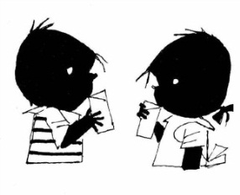
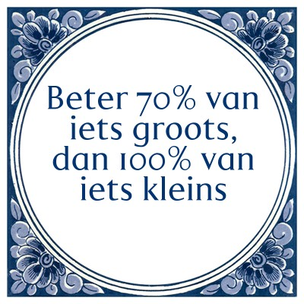
Crux with entrepreneurs
Simple explanation of the case offered, all-in all interesting (opportunistic..
How do clients think and the rest of the outside world?
Need to think in terms of business (➔ earn money), need to think in growth
Need to share?

Slide 18
Wat does Oost NV (our network) do in this context?
Intermediairs
Investors
- intake
- advies
- workshops
- matching
Entrepreneurs
- intake
- advies
- workshops
- matching
Intermediairs
Intake (ca 220 per year, OostNV)
Business and matching preparation (ca 60 a 70 yearly, 2014: 11 matches
workshops & training (pitching, equity, coaching, legal)
deal flow:
Matchings workshops ( every 8 weeks, theme-investorslounges) with partners
More and more one-on one matching, Management Buy-ins
Club deals with other investors (incl our own PPM Oost)

Slide 19
Bottlenecks in Business Angel Investment (research BANN)
Lack of entrepreneurial quality, arrogance;
lack of quality businessplan;
Unrealistic proposals;
Insufficient interesting plan;
High intermediairy costs;
➔ Level playing field in the market is insufficient

Slide 20
Market Trends
Start-up finance: less subsidies, more own money needed
For topclass start-ups enough BA-money in the market
Growth companies: Business Angels are interested
Syndicates of BA’s (next sheet)
Internationalisation
Leverage to attract Bank Loans
Crowdfunding

Slide 21
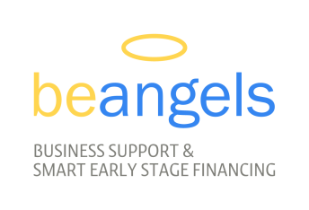
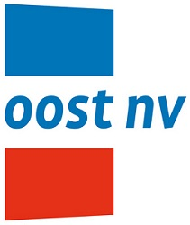

Slide 22
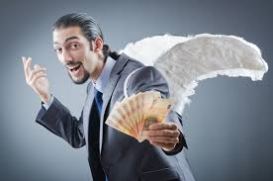
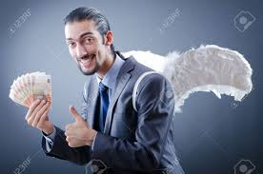
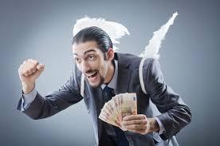
What’s your impression of BA’s?
“Does it make sense?”
What’s needed in your region?
How to learn from each other?
tips and tricks welcome!

Slide 23
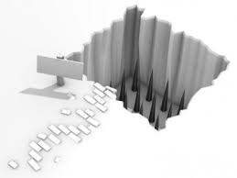
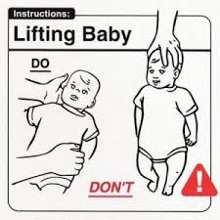
So let’s get started!

