Slide 1
Interreg Europe
Benoît Dalbert
Policy Officer | Interreg Europe Secretariat
b.dalbert@interregeurope.eu
27 May 2016AGORADA 2016 - Brussels

Slide 2
Summary
Key programme features
Interregional cooperation projects
Policy learning platforms
1st call results
3rd call & assistance to applicants

Slide 3
Key programme features

Slide 4
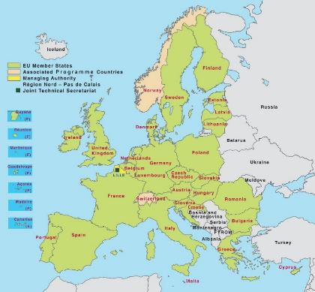
Geographical & thematic focus
The only Interreg covering
EU 28 + NO & CH
A thematic programme

Slide 5
Interreg Europe rationale
Objective set in the ETC Regulation - Article 2(3)(a) for interregional cooperation:
“to reinforce the effectiveness of cohesion policy”
“identification and dissemination of good practices with a view to their transfer principally to operational programmes under the Investment for growth and jobs goal but also, where relevant, to cooperation programmes”

Slide 6
Interreg Europe rationale
Exchange of experience to improve performance of policies for regional development, in particular Structural Funds (SF) programmes
EU Cohesion policy
Goal 1: Investment for growth & jobs
EUR 340 billion
Goal 2: European Territorial Cooperation
EUR 10.2 billion
INTERREG EUROPE
EUR 359 m

Slide 7
Target groups
Managing
authorities
Regional / local authorities
Learn from each other to improve policies
Agencies, institutes, private non-profits

Slide 8
Projects: who is eligible?
Public bodies - main target group (e.g. local, regional, national authorities)
Bodies governed by public law (Directive 2014/24/WE)
Private non profit bodies
Co-financing rates | According to legal status or location
85% ERDF | Public or public equivalent from EU
75% ERDF | Private non-profit from EU
50% Norwegian funding | Public, public equivalent and private non-profit from NO
Swiss funding | Public, public equivalent and private non-profit from CH

Slide 9
Supported actions
Projects
Involving limited number of regions
2 phases
Stakeholder groups
Action Plans
Policy learning platforms
Open to all
Closely related to projects

Slide 10
Platforms: definition
A service provided per priority axis via:
Online collaborative tool
With relevant functionalities
Expert team
Content & coordination

Slide 11
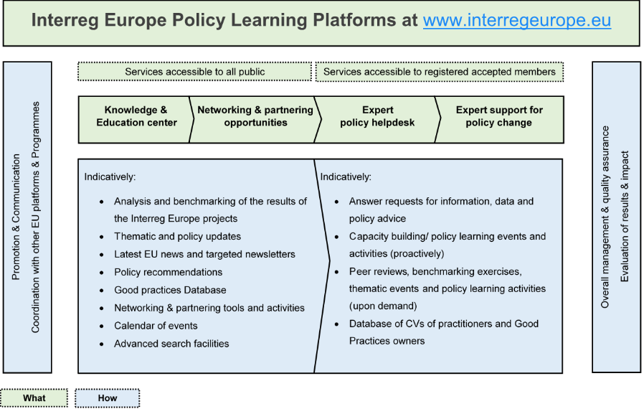
Platforms: services provided
Notes:
The 4 services following interest for involvement of the users. These categories are presented as non exhaustive, subject to legal restrictions.

Slide 12
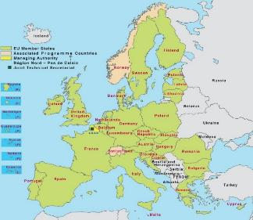
Two interrelated actions
Policy Learning Platforms
Open to all regions
Enrich
Contribute
Interregional cooperation projects
Project 1
Project 2
Project 3

Slide 13
1st call results

Slide 14
Submitted/ approved projects
261 projects submitted
64 projects approved

Slide 15
Types of organisations involved
No. of organisations involved: 545
Out of which…
Public bodies / bodies governed by public law: 486
- Local/regional/national public authorities: 264 - Regional Development Agencies: 48
Private non-profit bodies: 59

Slide 16
Examples of topics addressed
SME competitiveness
Access to finance (e.g. ATMforSMEs)
Internationalisation (e.g. SIE)
Social enterprises (e.g. SOCIAL-SEEDS)
Support to sector (e.g. RuralGrowth)
Young entrepreneurs (e.g. iEER)
Reduction of admin. burden (e.g. PURE COSMOS)
Innovation capacity of SMEs (e.g. INNOGROW)

Slide 17
3RD call & Assistance to applicants

Slide 18
3rd call for proposals
Launch of 3rd call depends on outcomes of 2nd call
Timing: Spring 2017
Topics covered: opened to all themes or restricted?
Available budget: ? (remaining budget)
Duration: shortened duration?

Slide 19
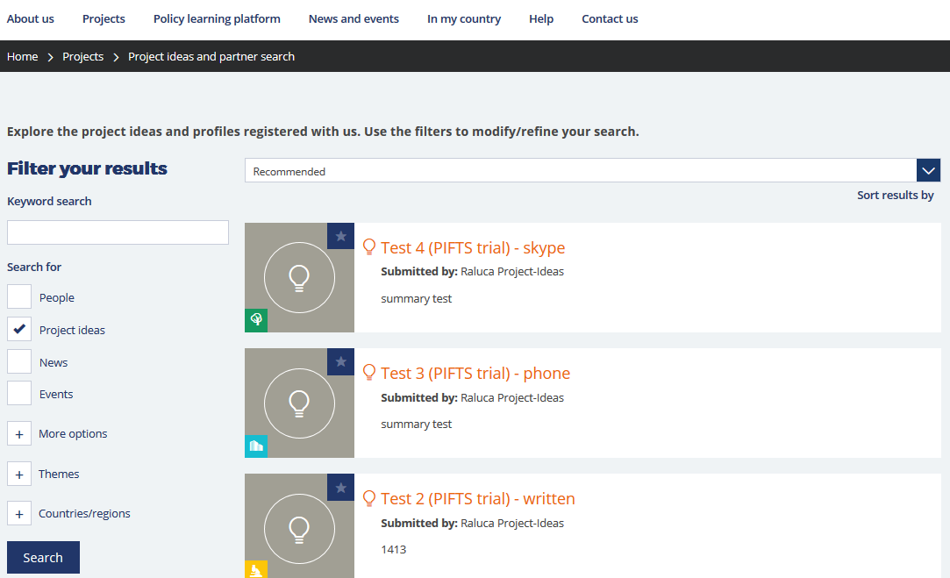
Support tools
1. Online partner search and project idea database
http://www.interregeurope.eu/projects/project-ideas-and-partner-search/

Slide 20
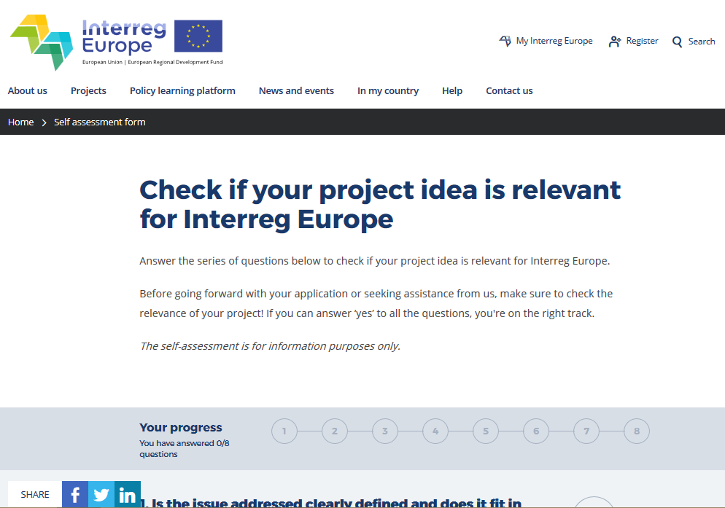
Support tools
2. Self assessment tool
http://www.interregeurope.eu/self-assessment//

Slide 21
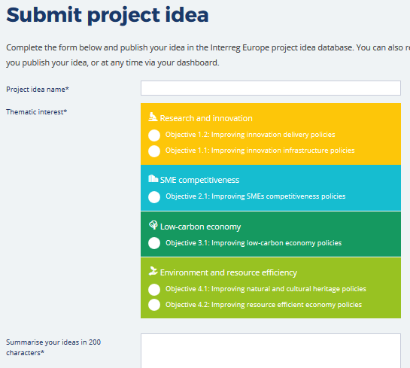
Support tools
3. Project idea feedback/ individual consultation

Slide 22
Support tools
4. Approved projects database
http://www.interregeurope.eu/news-and-events/news/39/first-call-projects-approved/
5. Information days
http://www.interregeurope.eu/in-my-country/
6. Q&A sessions
Regular live talk with potential applicants

Slide 23
Support tools
7. Lead Applicant webinars
Designing project methodology
Building relevant partnerships
Managing budget and finances
Planning a project communication strategy
8. National support to applicants
http://www.interregeurope.eu/in-my-country

Slide 24
Thank you! www.interregeurope.eu
Questions welcome

