Slide 1
Difficulties of Greek SMEs in accessing finance: The Case of Microfinance
Isabel Salgueiro
KEPA Brussels Office
27 May 2016

Slide 2
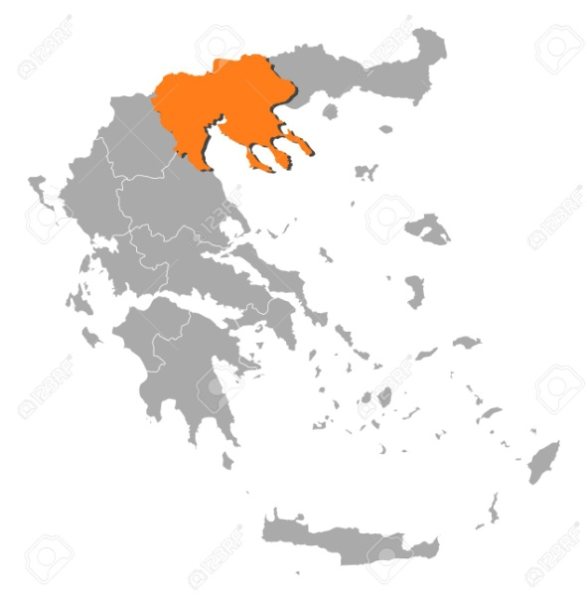
KEPA - Who we are
WHO we are
Non-profit organisation under private law, based in Thessaloniki, Greece
73 employees + EU projects department (3) Brussels office (1)
WHAT we do
Intermediate management authority for Center and Western Macedonia on programmes for SMEs and entrepreneurs > OP ‘Competitiveness, Innovation and Entrepreneurship’ ERDF
European projects > microfinance, social economy and design for innovation
Notes:
KEPA (Business and Cultural Development Centre) is a non-profit organisation based in Thessaloniki, Greece. KEPA is as an intermediate management authority for the region of Center and Western Macedonia on funding programmes for SMEs and entrepreneurs on behalf of the Greek Ministry of Competitiveness and Development, including the operational programme "Competitiveness and Entrepreneurship" 2007-2013 (ERDF). KEPA also possess a broad experience in EU projects.
For the last few years KEPA has been promoting design for innovation in Greece. [Design-thinking is an innovation methodology]. KEPA is partner of two major EU projects on design for innovation: SEE platform and DesignForEurope. Moreover, we have been recently awarded an INNOSUP (Horizon 2020) on this topic: TourismID, on design-thinking applied to the tourism sector.
KEPA is also actively working on the field of microfinance and social economy. Member of MFC (Microfinance Center), it is worth noting the project Microstars (Interreg Greece-Fyrom), whose aim is to "provide business development services or BDS in the cross-border area that will support micro-entrepreneurs and facilitate the establishment of start-ups".

Slide 3
Microfinance - EU definition and context
Microcredit = loan up to EUR 25 000, targeted to vulnerable groups and microenterprises with difficulties accessing the conventional credit market
Provided alongside Business Development Services. MFIs “will provide mentoring and training programmes” (BDS) to the beneficiaries, “before and after the creation of the micro-enterprise”
EC, EaSI Regulation
To promote microfinance, since 2010 > European Progress Microfinance Facility (Progress Microfinance) + JASMINE (technical assistance)
Notes:
“Microcredit has a double impact: an economic impact, as it allows for the creation of income generating activities; and a social impact, as it contributes to the social inclusion and therefore to the financial inclusion of individuals”.
EMN (European Microfinance Network)

Slide 4
Microfinance - KEPA’s actions
Microfinance as a new service complementing already-existing activities of KEPA to support entrepreneurship and SMEs:
2011/12 first contact (Task Force Greece, Adie)
2013 beneficiary of JASMINE
Member of Microfinance Center
2015 Project microSTARS
Development of BDS portofolio
Financial literary tools
2 pilot centers , in cooperation with Cooperative Bank of Karditsa
2016 May > Meeting with EIF in Thess.
BUT…
Notes:
Comme activité complémentaire à ses programmes d’appuie aux PMEs, depuis 2013 KEPA essaie de mettre en place un système de microfinancement (octroi de microcrédits avec des services d’accompagnement), similaire à Adie (France) ou Microstars (Belgique).
À ces fins, en 2013 KEPA a participé au programme d’assistance technique JASMINE du Progress Microfinance programme (DG Employment):
« L'instrument européen de microfinancement Progress, lancé en 2010, vise à accroître l'offre de microcrédits — à savoir des prêts de moins de 25 000 euros — destinés à la création ou au développement d'une petite entreprise ».
In 2013, KEPA was selected as beneficiary from JASMINE for technical assistance. KEPA has received assessment of its exsiting structure and its MFI business plan from Microfinanza Rating
Le monopole des banques n’est seulement en Grèce (par exemple, la situation est la même en Allemagne). Il faut nécessairement coopérer avec des banques. Le Parlement Européen ainsi que les principaux acteurs du secteur (EMN, Adie) appuient une “libéralisation” du secteur, de façon à que des organismes non bancaires puissent octroyer des crédits. Les acteurs soulignent les particularités du secteur comme une question / une politique social plutôt que financière.
2015 KEPA commence un pilot avec les objectifs suivantes: développer la gamme des services d’accompagnement, préparer et tester des modules de formation (légale, fiscal, marketing), établissement de deux centres et tester le modèle. Collaboration avec et crédits octroyés par Banque Coopérative Karditsa.

Slide 5
Microfinance in Greece
De facto monopoly of banks
Banking law 4261/2014 > lending institutions need a specific authorization by the Bank of Greece > extremely strict requirements (EUR 18 million of initial capital) preventing non-bank institutions to operate.
Situation so far…
2011 > Progress Microfinance > Cooperative Bank of Peloponnese and Pancretan Cooperative Bank > problems of implementation
Foundations and NGOs providing BDS (Afi)
March 2016 > publication of report + workshops in Athens
May 2016 EaSI > Cooperative Bank of Karditsa signed the first guarantee agreement with EIF
Notes:
At the end of 2011 the Pancretan Cooperative Bank and EIF (European Investment Fund) signed a senior loan under the PROGRESS Microfinance Facility. Due to difficulties within the Pancretan Cooperative Bank, such as liquidity issues, PROGRESS funds could not be made effective until recently. Currently, it appears that the Pancretan Cooperative Bank provides microloans on a small scale. Currently SESNet and the Cooperative Bank of Karditsa (CBoK) are in the process of laying the ground for establishing a microfinance facility. To this end, CBoK has applied successfully for EaSI Technical Assistance, and applied for an EaSI Guarantee for future microfinance operations.
Under the Progress Microfinance initiative, EIF is a partner of Pancretan Cooperative Bank, which is providing micro-loans for a total amount of EUR 6.0m to more than 1 000 microenterprises and self-employed in Greece, contributing to job creation and local development.

Slide 6
Microfinance in EU – A case for non-banks
Microcredit is not strictly a banking activity
Specific nature of microcredit > social policy vs. financial policy
Addressed to a non-bankable segment > not target of banks
Importance of offering BDS (not core business of a bank)
Due to legal restrictions, non-banks MFIs forced to collaborate with banks (‘partnership model’)>
Accept bank’s terms and conditions
Lack of independency hindering long-term sustainability
Depending on banks to access funds (e.g. EaSI)
Poor implementation of Progress in countries where there is a monopoly of banks
2007-2013
Microfinance most needed, and not implemented!
Notes:
Social micro-lending in industrialised areas with a highly developed banking system is not in fact banking but a social policy initiative which uses credit for specific purposes.
The specific nature of microcredit is not generally taken into account in national or EU legislation.
Indeed, in most jurisdictions, the provision of microcredit is considered a financial activity and falls in the scope of general applicable laws on financing and providing loans. For instance in Belgium, Finland and Luxembourg there are no specific rules related to microcredit. More rarely, certain jurisdictions provide specific regulations regarding non-banking institution.
Non-bankable segment: the creation of enterprises by vulnerable persons who, in order to have access to banks in the absence of guarantees, must have start-up capital and a history of microcredit.
Regarding the cooperative model Banks need to do its own risk assessment and due diligence (double work for the same client) and much higher total cost of credit
Banks in Greece have a huge overhang of bad debt that needs to be recovered
Delicate questions:
Supervision and supervisory body. In Greece, the best institution to do this would be the Bank of Greece, since it is the institution monitoring all financial activities in Greece (banks, leasing, insurance companies, money transfer). But the Bank of Greece is overwhelmed with problems. An alternative KEPA has proposed is that the supervision is made by the Hellenic Capital Markets Commission: they monitor the Greek stock exchange and venture capitals.
Seed capital. These should be a flexibility in the timeline for collecting seed capital. There must be a grace period for fund raising. KEPA’s suggestion: Starting share capital. A minimum amount of 100.000 euros must exist as a starting capital, an din a timeline of 2-3 years this must be raised up to at least 1.000.000 euros.

Slide 7
Microfinance in EU – Final remarks
Microfinance is trapped in a regulation that it is not meant for it > some rules should be reviewed (including interest rate caps)
“The possibility for non-banks to act as microcredit intermediaries should be extended to all the Member States”
European Parliament (2015), “Report on the implementation of the European Progress Microfinance Facility”
Non-bank MFIs need to be either regulated or better regulated, taking into account their specificities and differences with banks
“Microfinance schemes put in place should become independent of public subsidies, but MFIs reach out to the most disadvantaged and advice and BDS will need to be subsidized”
fi-compass event (February, 2016), European Microfinance Network

Slide 8
THANK YOU!! THESSALONIKI KEΠΑ (www.e-kepa.gr) tel: +302310480000, fax: +302310480003, mob: +306972220969, Skype name: stamkos.neoklis 6th klm. Charilaou-Thermi, Lida Maria Block, Hermes Building, P.C. 57001 Thessaloniki, Greece BRUSSELS Brussels bureau: 3 Rue du Luxembourg, 1000, Brussels salgueiroi@e-kepa.gr tel, fax: +3225116711

