Slide 1
European Energy Efficiency Fund - EURADA Brussels, May 2016

Slide 2
eeef at a glance
Objective
eeef is an innovative public-private partnership dedicated to mitigating climate change through market based financing in the member states of the European Union
Beneficiaries
Municipal, local and regional authorities or public and private entities acting on behalf of those authorities such as utilities, public transportation providers, social housing associations, ESCOs etc.
eeef’s capital
Initial capitalization of the fund provided by the European Commission, the European Investment Bank, Cassa Depositi e Prestiti and Deutsche Bank
Investments
Fund’s investments are split into three project categories:
Energy Efficiency (EE)
Renewable Energy (RE)
Clean Urban Transport

Slide 3
Cities/regions to deal with challenges when considering energy efficiency projects
Key challenges
Baseline
Insufficient data about energy consumption and street lighting maps
Upfront development costs/limited capacity and staff resources
Long-term commitment
Tender requirements
Know how of tender procedures taking national and EU tender requirements into account
Design knowledge and technical know how required
Procurement process linked to energy performance and NPV
Obligations/
guarantees
Quality of the guarantee provided by the ESCO requires additional comfort
Obligations under the existing O&M structure
Uncertainty of savings and perception of risk
Financing
Limited capital availability
Financial situation of the municipality and legal requirements/ limitations with regard to increased debt level (Eurostat in respect to EPC related payments)
3

Slide 4
Highlights of the eeef
Know how pooled on the European level
The Fund is acting as center of competence for financing of EE and RE projects with a public link across jurisdictions – currently working with 23 cities, regional authorities in Europe
Experienced professionals serving public and private institutions along the investment decision process
European
investment approach
European wide project sourcing ensures sufficient deal flow (total project volume and number of projects)
Risk diversification of portfolio across EU28 Member States
Leverage of private capital
Leveraging of EC commitment with private capital increases total financing available to cover public investment needs in the EE and RE sector
First loss taken by C-shares provides attractive risk structure for private investors
Acting in tax payers
benefit
PPP financing ensures realization of economically reasonable projects only
Primary energy and/or CO2 savings contribute to the achievement of the 20/20/20 goals

Slide 5
eeef is designed to support cities/regions along the
energy efficiency investment circle
Specific targets for European cities
Political support to launch
the projects
Start
City implementing investments
and reporting achievements of
targets
EU CO₂ and
energy targets
CO₂ and
energy
reporting
Lack of capacities for self funding due
to austerity policies/limited budgets
Commercial banks do not support
project development
eeef allowed access to the Technical
Assistance (TA) attached to the Fund
Energy
efficiency
investment
circle
Project
develop
ment
phase
support
Primary
energy
savings
targets
achieved
eeef
eeef requires selected ESCOs
to provide guarantees for
energy savings to the City,
which are aligned with the tender
reuirements
Access to
financing
• Many funders perceive energy
efficiency projects as high risk projects
eeef’s objective is to fund projects reaching energy efficiency targets aligned with City’s strategic plan
Financing
Instrument
Depends on results of the project development phase
eeef flexibility in offering financing solutions
eeef with a right to match first the funding due to TA involvement

Slide 6
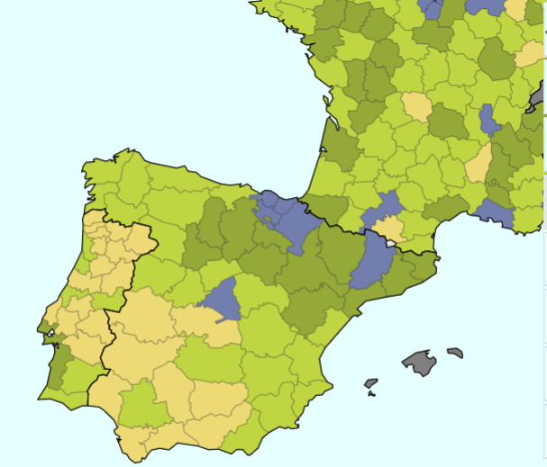
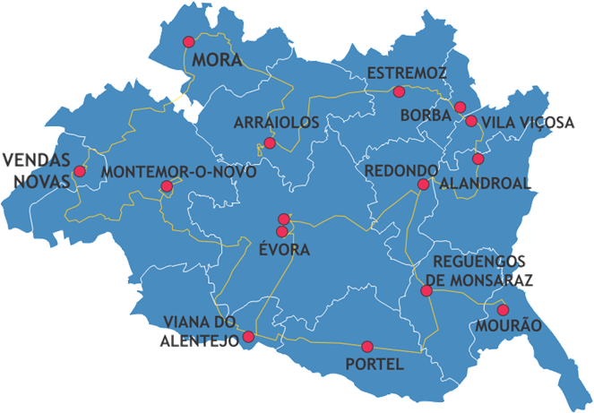
eeef is cooperating with the Region of Alentejo in Portugal along energy efficiency investment circle
CONTEXT
1 region, 1 UNESCO World Heritage City
14 municipalities
50 vehicles
150 buildings
60.000 Public Lighting Points
161.092 inhabitants
2.5M€ in Public Lighting consumption per year
4 MAIN GOALS
Energy Efficiency in buildings
Energy Efficiency in urban vehicles
Energy Efficiency in public lighting
Energy production in small scale pilots with renewable energies
STRATEGIC RESOURCES
Common strategy and common goal for 14 mayors and cities
Necessity to improve efficiency in the usage of resources available
TA from the European Energy Efficiency Fund (600k€/90% funding)
More than 10 years of consistent regional projects development
Focused multidisciplinary team to support project development
EXPECTED RESULTS
Structural Regional Energy Efficiency Plan
Improved operational management of energy related asset
Energy Management Integrated Operations Centre
12M€ ESCO investment in Energy Efficiency (EEEF funding)
5M€ Municipal investment in Energy Efficiency (ERDF)
EU CO₂ and
energy targets
CO₂ and
energy
reporting
Energy
efficiency
investment
circle
Project
develop
ment
phase
support
Primary
energy
savings
targets
achieved
eeef
Access to
financing
Financing
Instrument

Slide 7
ESCO investment - for larger investments, experienced counterparties are crucial
Typical SPV structure overview
ESCO Partner
Municipality
Junior funds
Repayments
Capital injection
Special Purpose Vehicle (SPV or ESCO)
Senior debt
Construction and O&M
contracts
eeef
Sub-contracts
EPC partner
O&M partner/s
Advantages of off-balance sheet solutions
Procurement process on overall performance and economic benefits to the City
Private sector expertise to design, implement and optimize operation
Off balance sheet financing requires no own upfront investments by the municipality
Financial savings from the beginning possible to release funds for other purposes or investments of the municipality

Slide 8
Example: energy efficiency upgrade of the University
Hospital S. Orsola Malpighi - Bologna, Italy
Project description
Partners: | Progetto ISOM S.p.A (project SPV) University Hospital S. Orsola Malpighi (grantor of concession)
Measures: energy efficiency CCHP | Upgrade of entire fluids’ production and distribution system of the hospital Including a tri-generation plant for the combined production of cooling, heat and power (CCHP)
Results: | Reduction of CO2 emissions of 14,136 t p.a., approx. 31% compared to baseline
Location
Bologna, Italy
Project structure
Investment characteristics
Key data: Total project volume: € 41m (equity provided by Manutencoop Facility Management, Siram, Sinloc and Iter Cooperativa Ravennate) EEEF funded volume: € 32m via a project bond structure Duration of financing: 20 years Construction completed start of 2016 Highlights: Largest energy efficiency upgrade in Italy under a Public Private Partnership (PPP) framework Complex energy efficiency upgrade of the hospital - won the 'CESEF Energy Efficiency Award 2015' in the Financial category
−
Manutencoop
Facility
Management
−
Siram
−
Sinloc
Equity funding
Project bond + VAT bond
SPV Progetto ISOM S.p.A.
EPC and O&M
EPC & O&M consortium
Concession agreement
UHSOM
(Grantor of
concession)
Regional funding
−
Region
of healthcare
Emilia
Romania

Slide 9
Financing of the Region’s own ‘ESCO’ -
Région Rhône-Alpes, France
Project description
Partner: | Région Rhône-Alpes, OSER
Measures: Public buildings retrofit | Rhône-Alpes region is committed to the Territorial Climate and Energy Plan Objective: Reduction of GHG emissions by 40% until 2020 Start of public buildings retrofit in some of the 271 public senior high schools
Current status: | Successful tender for the renovation of 8 schools in the Rhône-Alpes region with total investment volume of €20m Ongoing tender for a library and a city hall with additional investment volume of more than €5m
Location
Région Rhône-Alpes, France
Project structure
Investment characteristics
Key data: Construction facility/ senior debt: €5m Duration of financing: 5 years Highlights: Providing construction financing to attract additional commercial lenders for the Project after end of construction phase Bridge financing enables total investments of more than €25m First construction bridge loan structure provided by eeef Project benefited from a European Commission Technical Assistance Facility by the eeef
Projects owned by Région Rhône-Alpes
Execution of works and services
Rent upon project completion
Service & financing contract
Senior debt
SPL-OSER
Selection Surveillance etc.
Service Providers
Equity
Guarantee on debt portion in case of project abortion
Région
Rhône-Alpes

Slide 10
Key take aways since starting operations of eeef
L-o-o-o-o-ng way to the investment (should be reduced at some point of time)
Regions are in the driver seat : technical expertise, political support
No bankable project without viable feasibility study /project preparation
Projects with high energy savings should be commercially financed
No one solution for all: City/Regions to decide whether they leverage private finance or use their own funding
Full fledged procurement process in the PPP schemes is complex - should not be underestimated

Slide 11
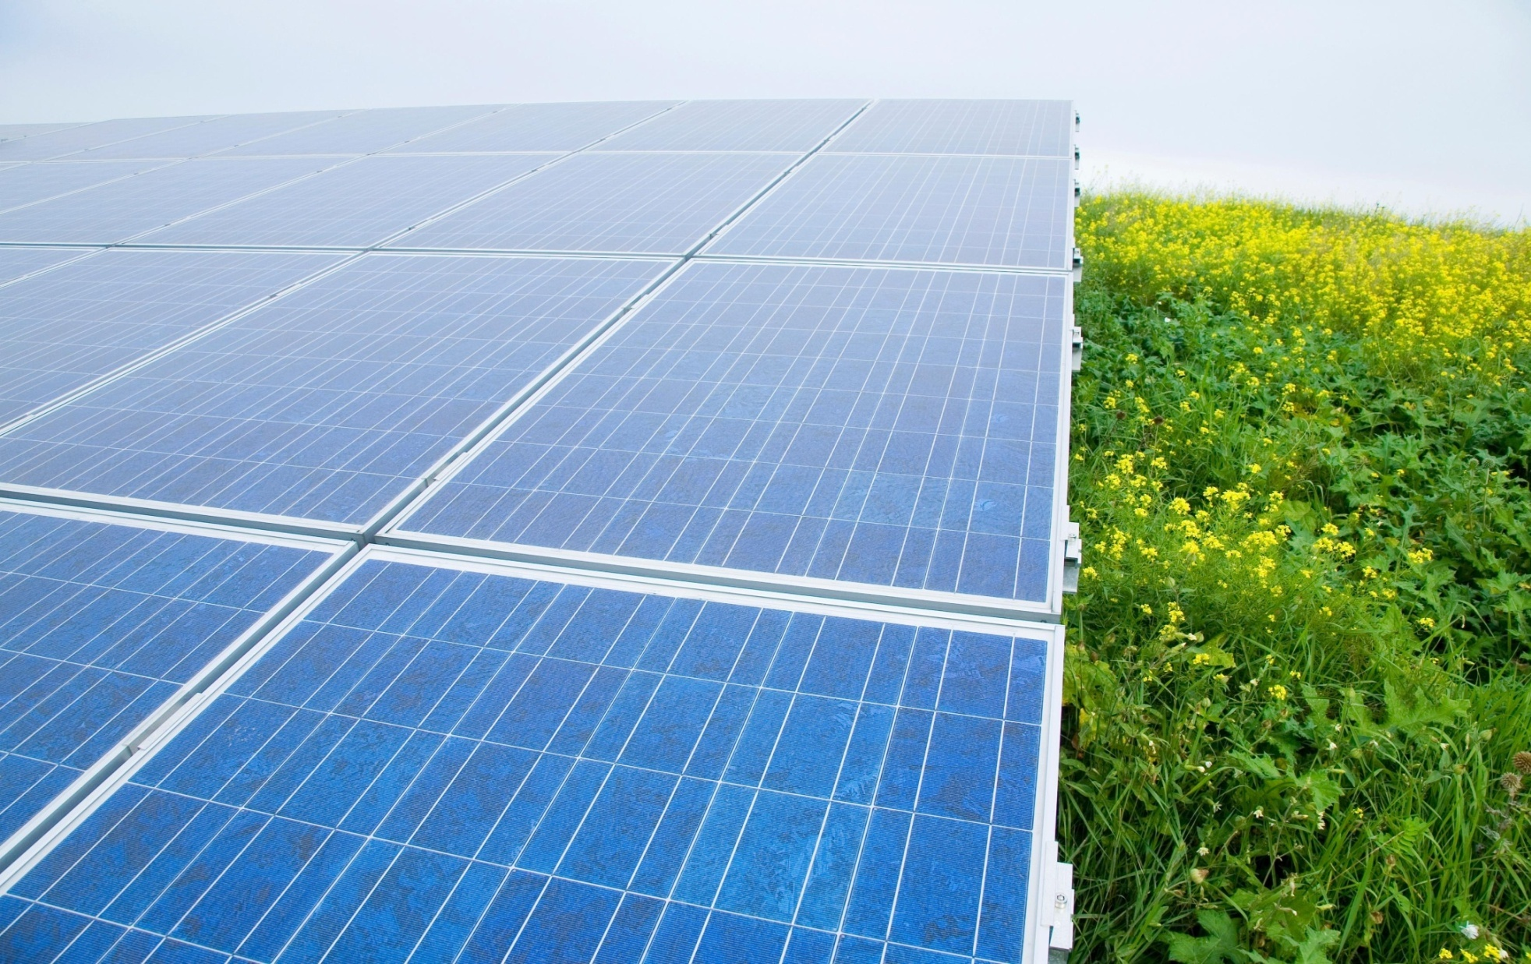
Contacts
European Energy Efficiency Fund (eeef)
Lada Strelnikova
+49 (69) 910 46444
lada.strelnikova@db.com
Matthias Benz
+49 (69) 910 46449
matthias.benz@db.com
Paola Rusconi
+49 (69) 910 84768
paola.rusconi@db.com
Zarpana Signor
+49 (69) 910 49858
zarpana.signor@db.com
www.eeef.eu

Slide 12
© Copyright 2015. European Energy Efficiency Fund, SICAV-SIF, 31 Z.A. Bourmicht, L-8070 Bertrange, Luxembourg. All rights reserved.
This presentation (the ‘Document’) has been prepared by European Energy Efficiency Fund, SICAV-SIF (‘European Energy Efficiency Fund‘) exclusively for the benefit and internal use of the potential client (‘Client’) in order to indicate, on a preliminary basis, the feasibility of a possible transaction or transactions. The Document may only be used for these purposes. The Client is not permitted to duplicate the information provided in this Document and to communicate the received information of this Document to any third party without the prior written consent of European Energy Efficiency Fund.
The Document is incomplete without reference to, and should be viewed solely in conjunction with, the oral briefing provided by European Energy Efficiency Fund. The Document is neither intended to serve as legal or tax advice nor should it replace it.
The information in the Document reflects prevailing conditions and European Energy Efficiency Fund's views as of this date, all of which are subject to change.
Neither the European Energy Efficiency Fund nor their directors, officers, agents or employees, customers or professional advisers make any representation, warranty or undertaking, express or implied, as to the accuracy, reliability, completeness or reasonableness of the Document. The aforementioned persons will be under no duty to provide access to any additional information or to update or correct (if required) any Information. Accordingly, neither the European Energy Efficiency Fund nor the aforementioned persons will be liable for the accuracy, reliability, completeness or reasonableness of the Document.

