Slide 1
Financial instruments for regional development
The financial challenge
P. Rhemrev
Deputy Director PPM Oost NV
AGORADA 2016

Slide 2
Agenda
Oost NV & PPM Oost NV
The Financial Challenge
  Objectives fund
  Financial instruments for regional development
  Financial instruments
  Investment criteria
  Examples/best practices
  Lessons learned
Q&A

Slide 3
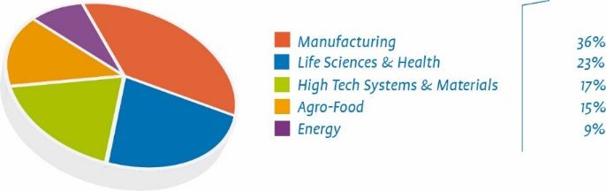
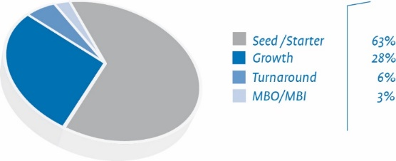
About PPM
Investment division Oost NV
Regional venture capital fund
Revolving fund
Private fund, public funding
€ 310 million under management
€ 110 million invested in portfolio companies
233 portfolio companies (129 GVI’s)

Slide 4
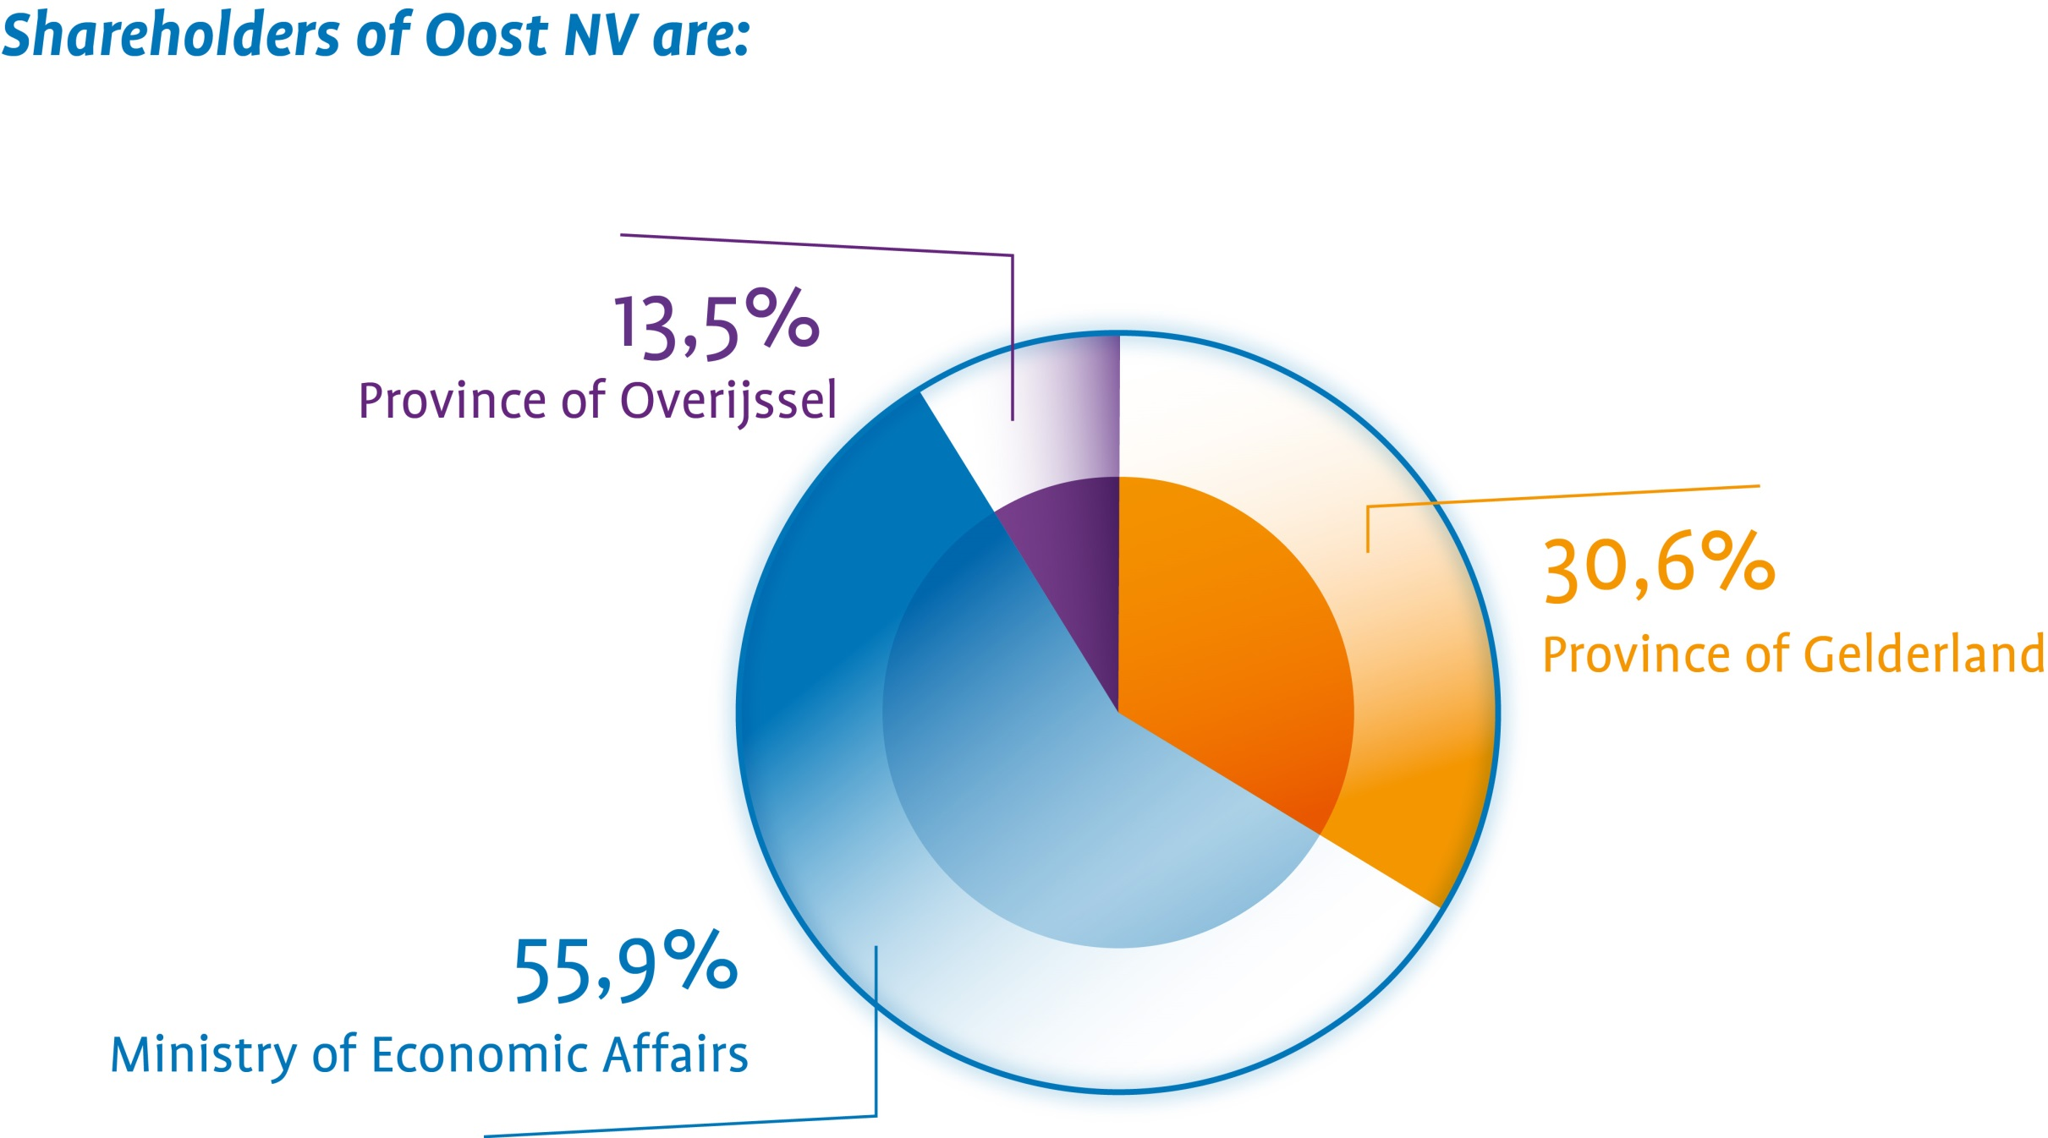
Shareholders Oost NV
Notes:
De opdrachtgevers en aandeelhouders van Oost NV zijn:
Het Ministerie van Economische Zaken (57,62%)
De Provincie Gelderland (33,5%)
De Provincie Overijssel (8,82%)
14-11-11
4

Slide 5
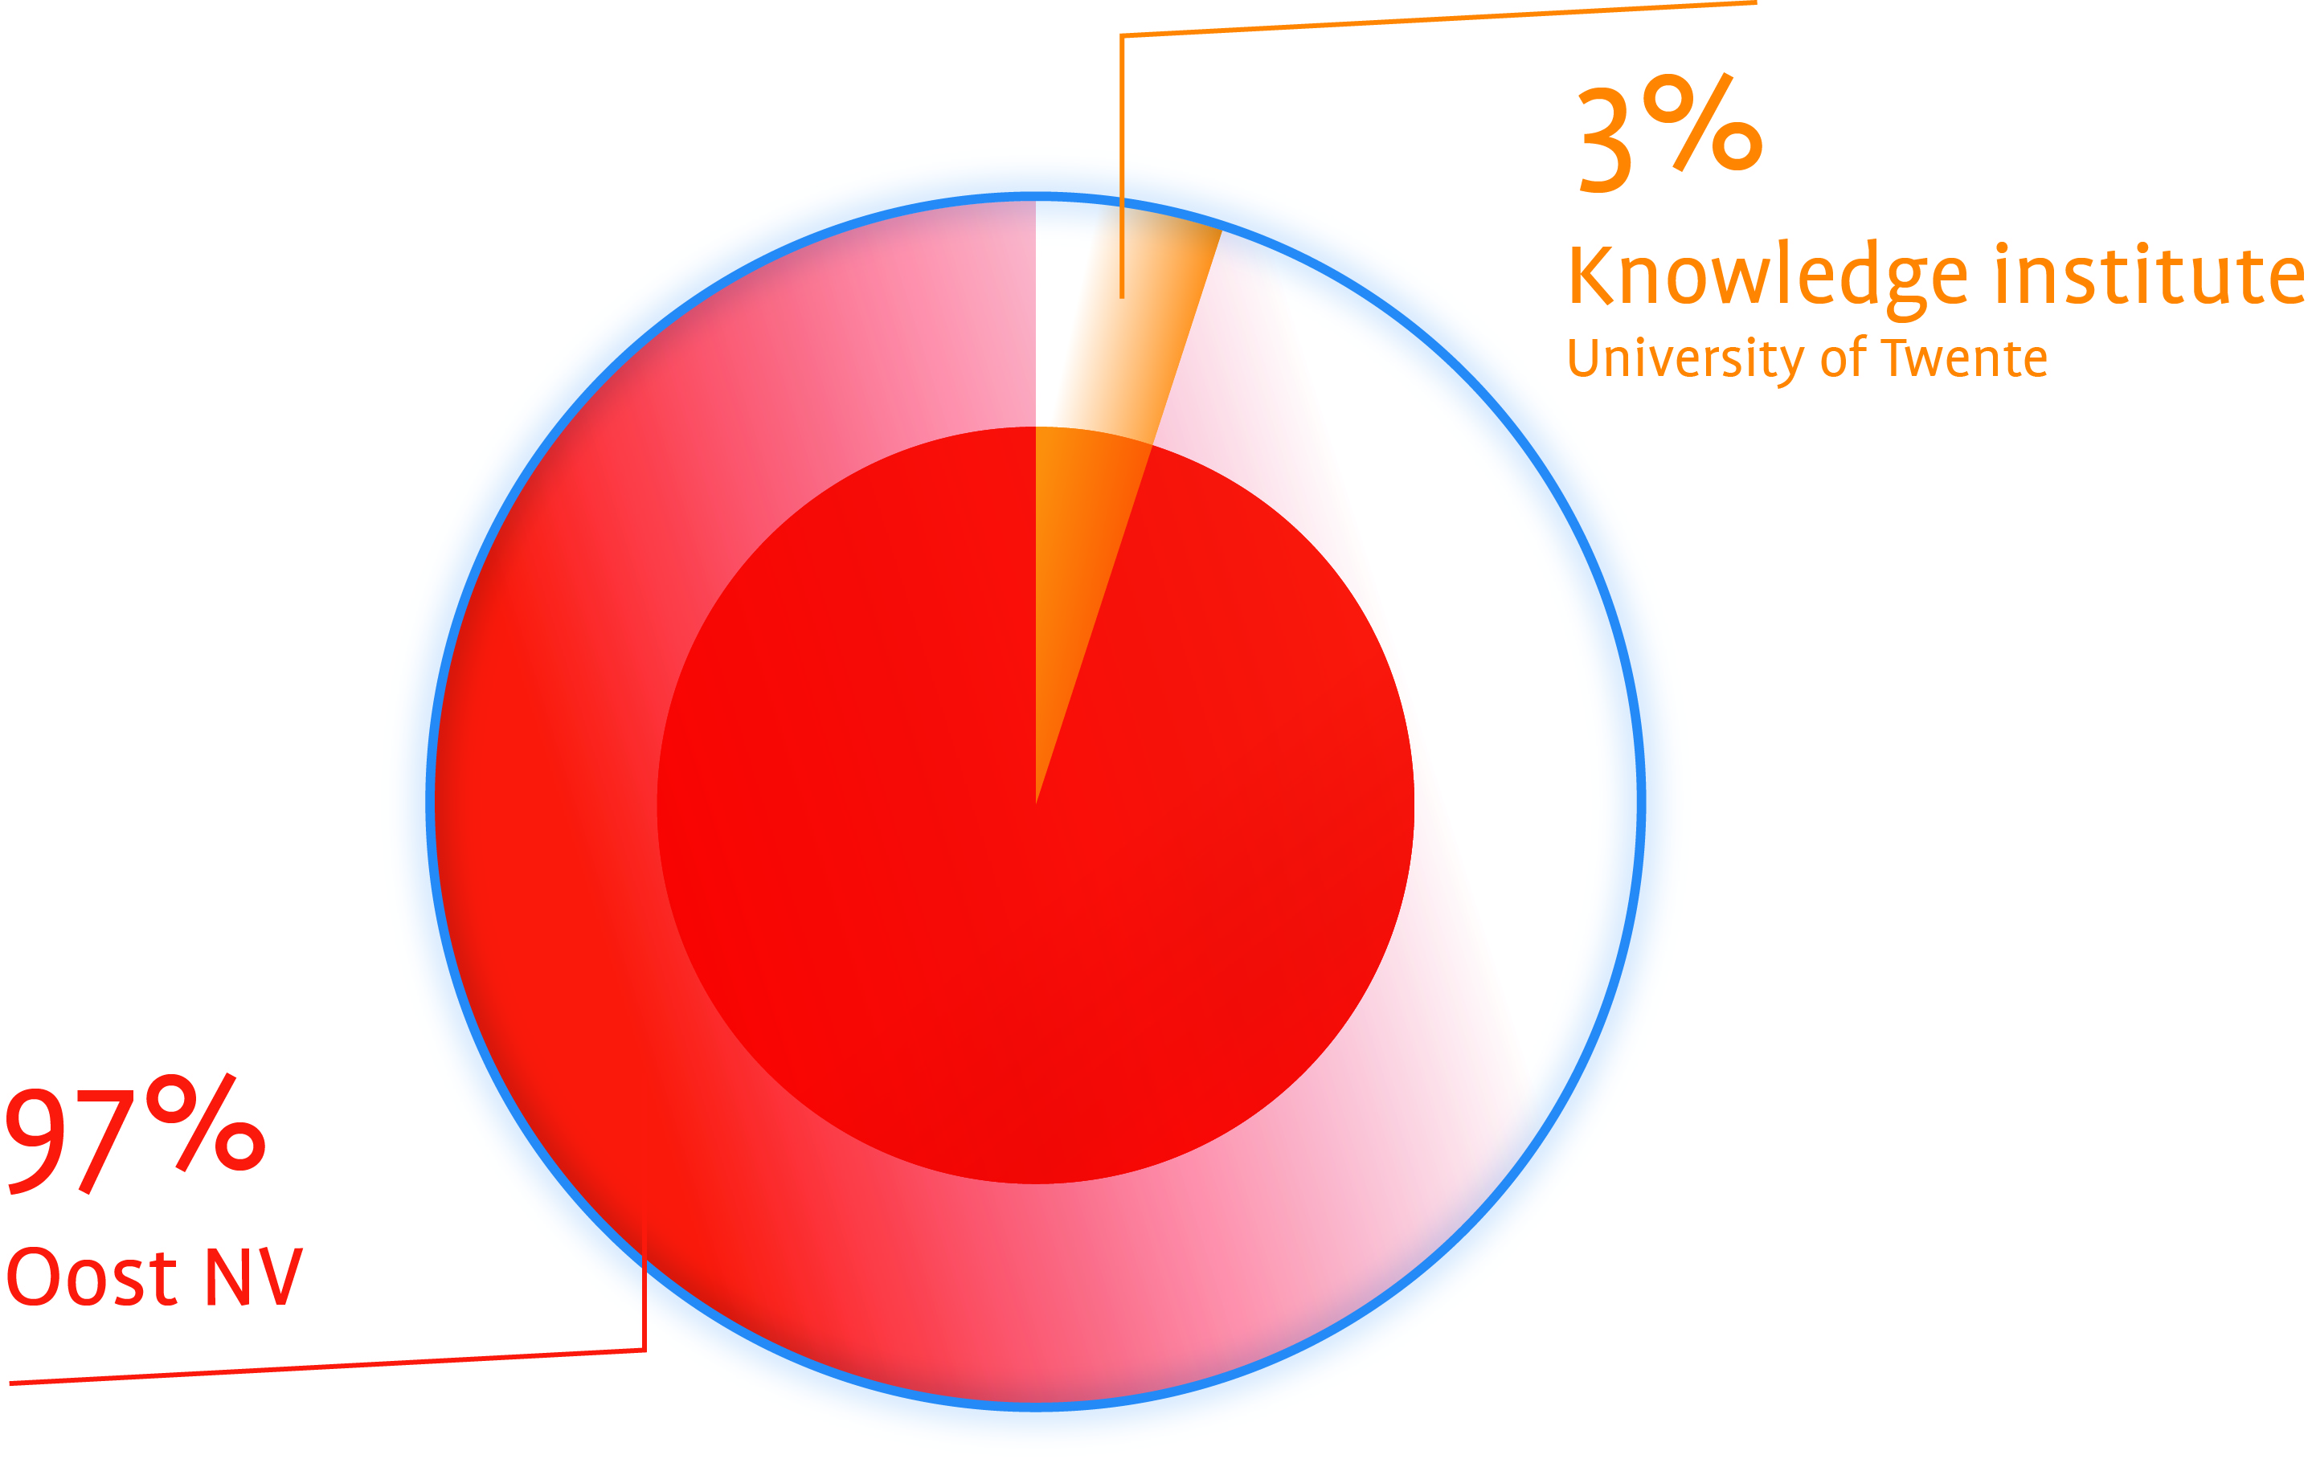
Shareholders PPM Oost
Notes:
Aandeelhouders PPM Oost:
95% Oost NV
5% Kennisinstellingen
14-11-11
5

Slide 6
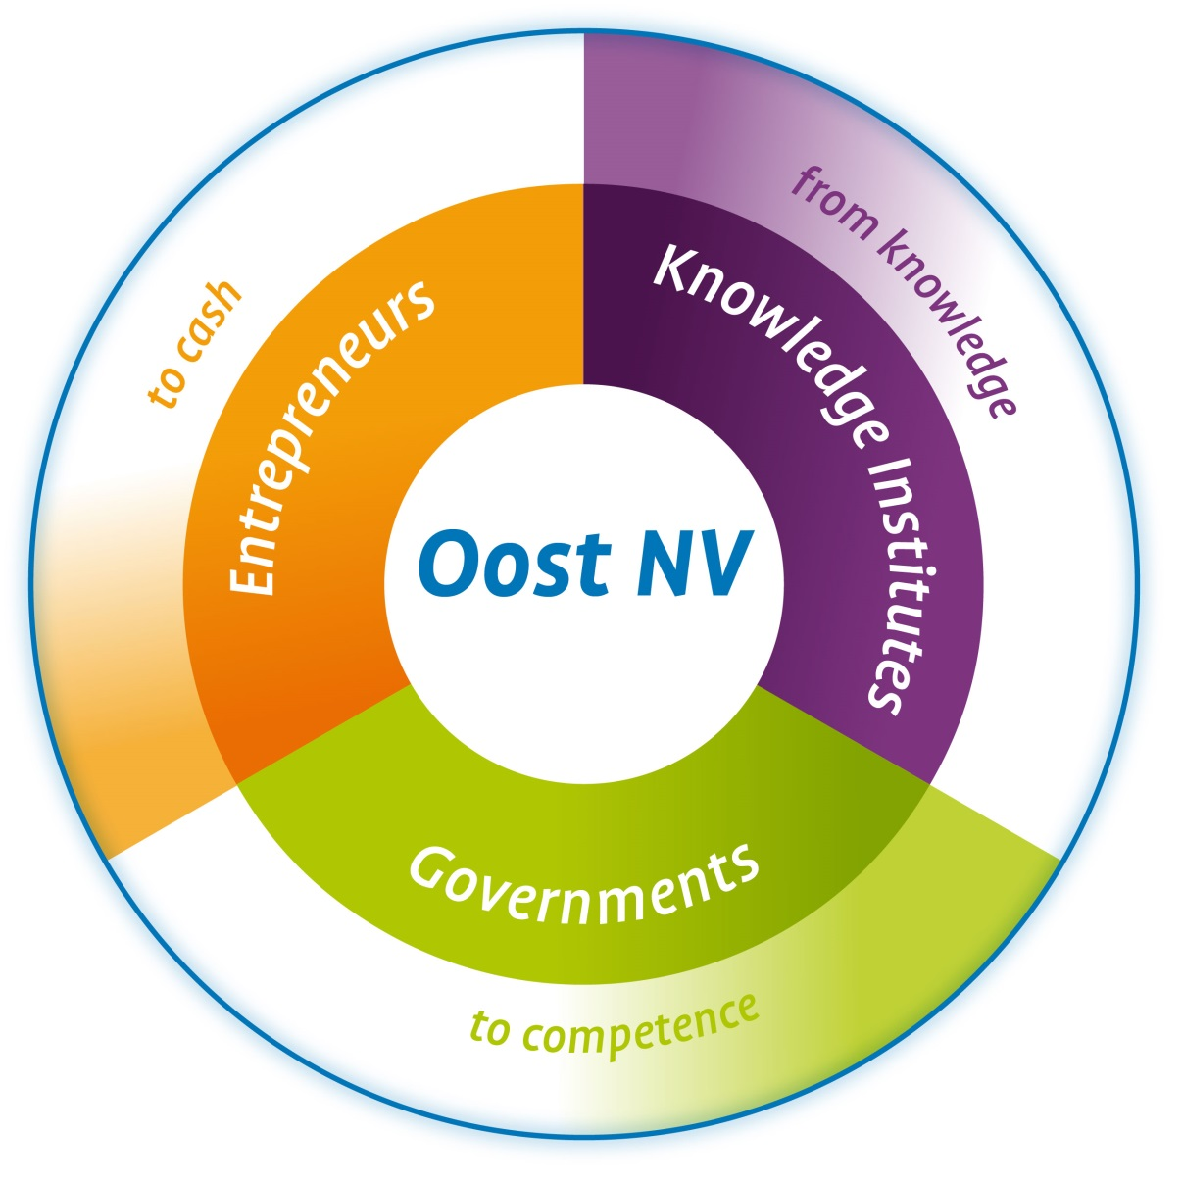


The connecting link
Notes:
14-11-11
6
Oost NV verbindt
Ondernemers
Onderzoek
Onderwijs
Overheden

Slide 7
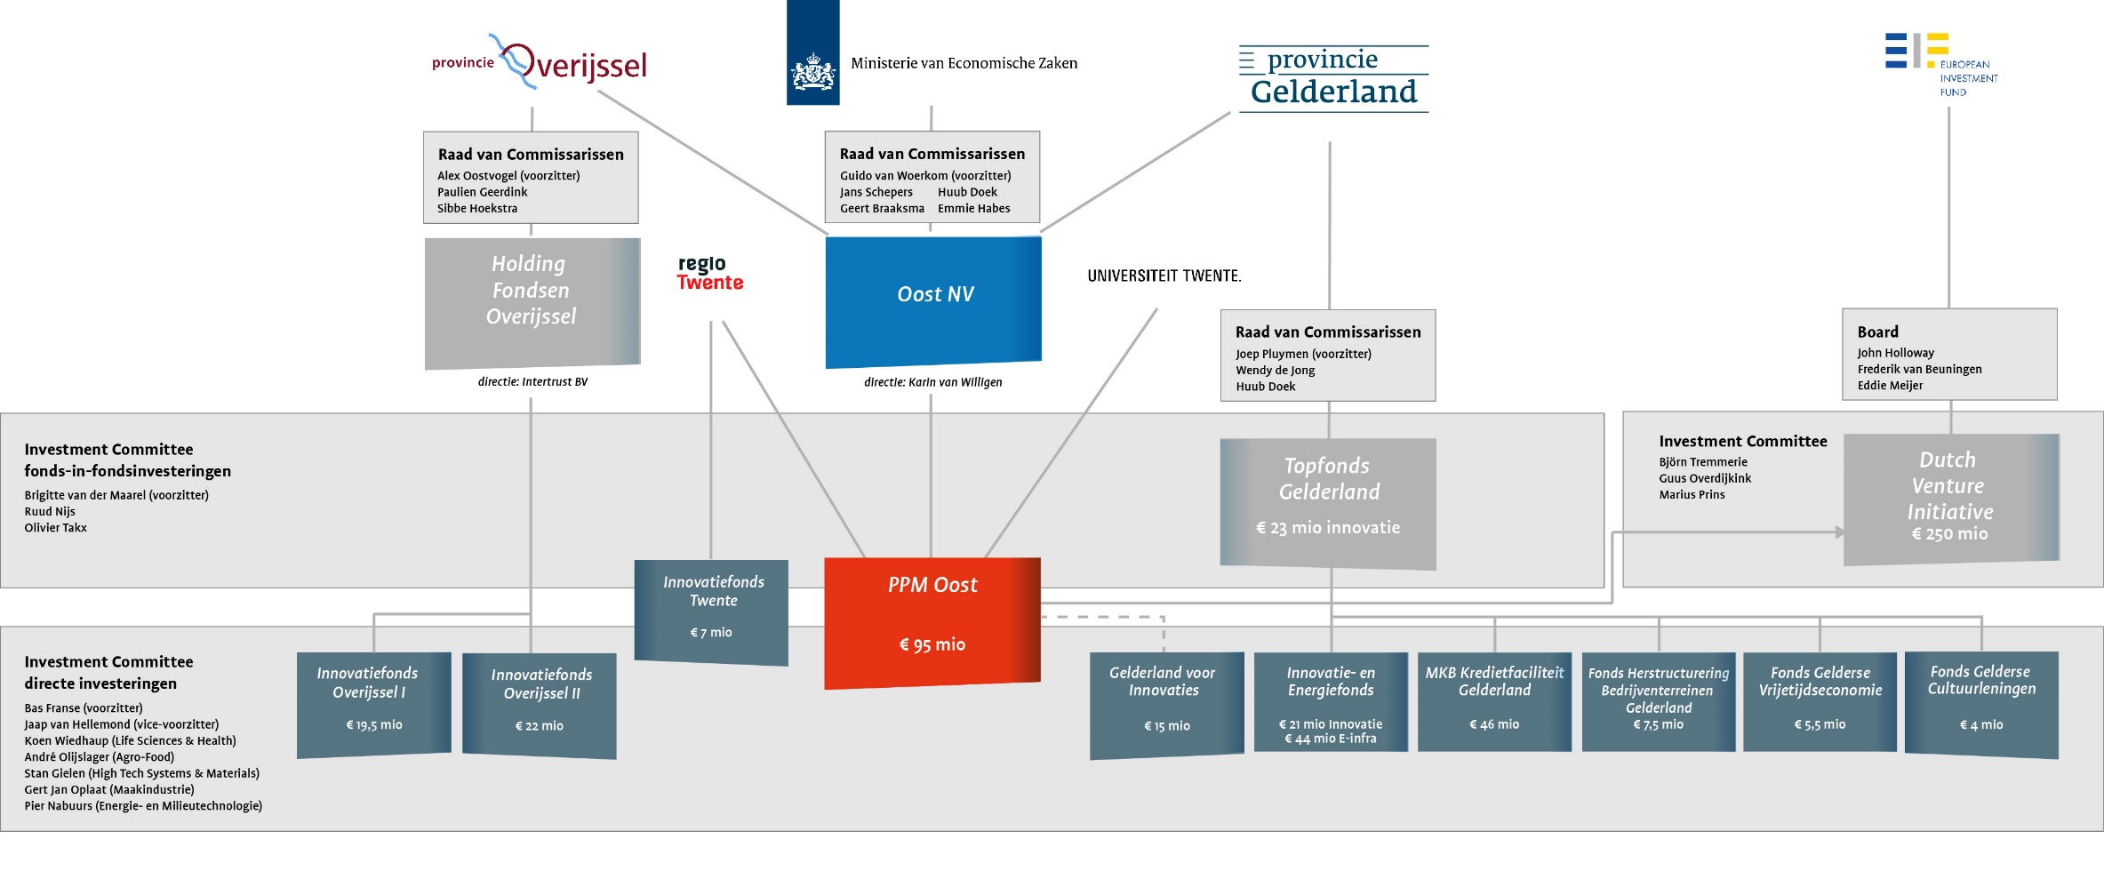
Governance PPM Oost
Notes:
Aandeelhouders PPM Oost:
95% Oost NV
5% Kennisinstellingen
14-11-11
7

Slide 8
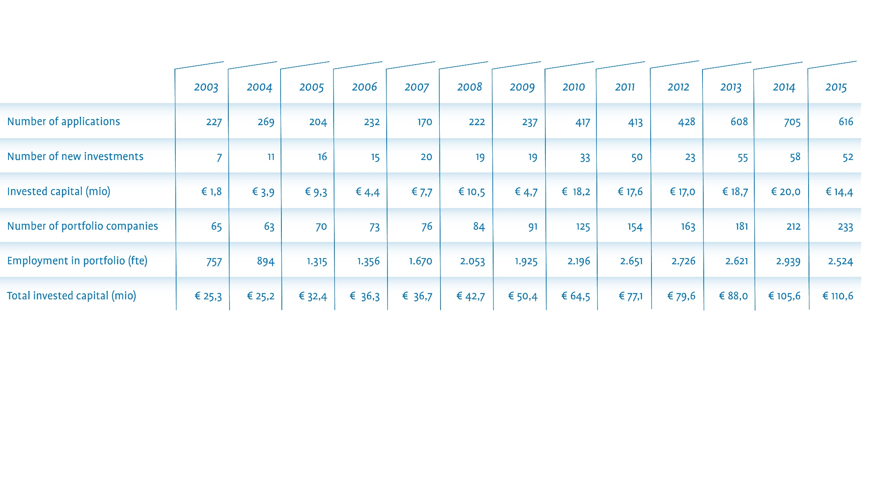
Facts & Figures PPM Oost 2003-2015

Slide 9
Available funds
Basic fund
TFG (FiF, IIG,GVI)
Specialty funds (restructuring environment/creative/leisure)
IFO I & II
DVI (I & II)

Slide 10
The Financial Challenge:
‘act like a public fund, behave like a private fund’
Objectives PPM Oost NV
Policy government
Insufficiency capital markets
  High risk
Strengthen social economic structure region (eco-system)
  Stimulation instrument
Encourage/stimulate entrepreneurship
Increase employment
Returns/revolving fund
Innovation

Slide 11
Financial Instruments
Small loans (€ 25k - €75k)
SME loan (€ 250k - € 2,5 mio)
Venture Capital (CAL/share capital)
Guarantees (export finance)
EU Programs (Oost NV)

Slide 12
Investment criteria
SME’s
Innovative (early stage) companies
Geographic limitation
Sector specific (Life Tech, High Tech, Clean Tech, Manufacturing Industry)
Leverage/matching fund
Economic impact
Investment amount: € 25k - € 75k/ € 250k - € 2,5 mio
Large minority shareholder; max 49%
Standard VC criteria
    Board & shareholders decisions
    Supervisory board/observer seat
    Exit (5-7 yr.)

Slide 13
Portfolio
Portfolio Companies PPM Oost, Categorised by performance
 | # portfolio companies | Exposure | % amount | % exposure
Blue | 12 | 12.172.728 | 17,6% | 21,4%
Green | 17 | 14.494.708 | 25,0% | 25,5%
Yellow | 18 | 12.385.758 | 26,5% | 21,8%
Red | 9 | 7.184.431 | 13,2% | 12,6%
Black | 12 | 10.589.900 | 17,6% | 18,6%
Totaal | 68 | 56.827.525 | 100,0% | 100,0%

Slide 14







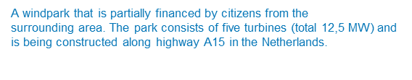







best practices
Criteria:
Societal/economic impact
Leverage
Employment
Software solution for cost efficient DNA
data processing and storage.
Unique HBr electricity storage system concept (patent pending),
whereby the full focus has been on minimizing the cost per stored kWh.
Through its innovation, Elestor has become the missing link in the energy transition.

Slide 15
Lessons learned
Criteria:
Objectives funds
Loan conditions
Expectations funders
Observations:
Public funded (private) funds works, but realisation expectations funders takes time
Market failure vs return
Start ups vs employment
Knowledge vs complexity business cases
Loans (good/bad instrument)
Capital intensive/ limitation funds
Exitability
Time
Accept failures

Slide 16
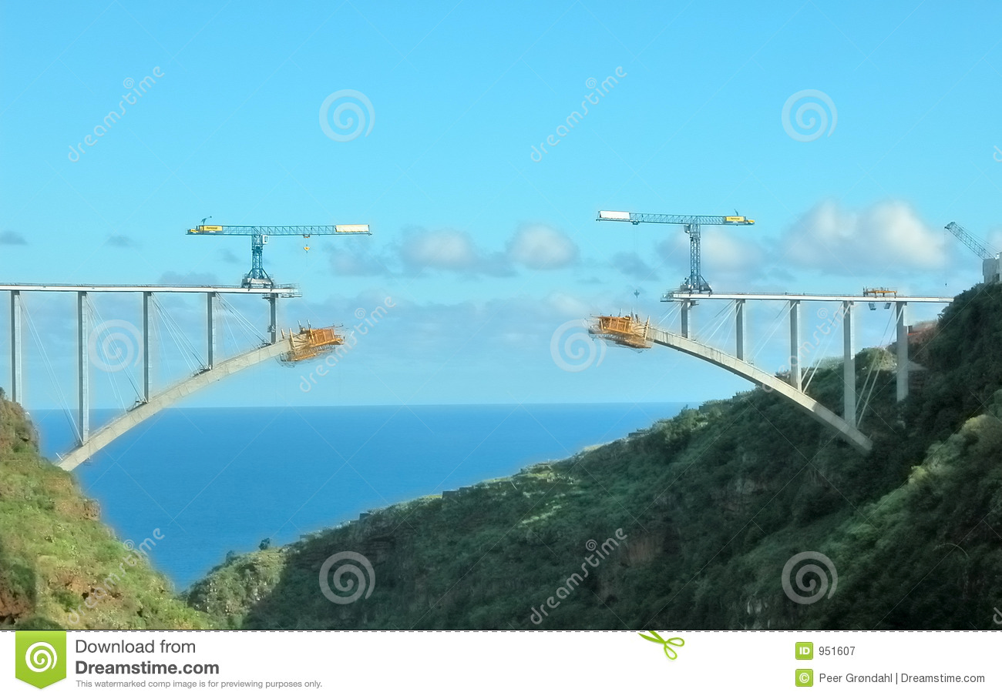
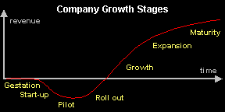


Lessons learned
Early stage ..(late stage)VC…PE
Efsi?

Slide 17
Q&A
Q
A

Slide 18
Thank you for your attention

