Slide 1
TechnoBit Seed Fund Venture
Stanisław Ginda
Regional Development Agency
Bielsko-Biała

Slide 2
Background
New experiences gained from participation in the pilot program „Support for the development of technological start-ups and for technostarters in 2007-2008”
Continuation of the activities planned in the Strategy for the Development of the Beskid Technology Incubator (BIT) in Bielsko-Biala 2006-2010
Adaption to the assumptions of EUROPE 2020 - A Strategy for smart, sustainable and inclusive growth for 2010-2020

Slide 3
The amount of funds obtained from the 7th Framework Programme (in million Euro)

Slide 4
The number of beneficiaries of the 7th Framework Programme

Slide 5
The number of beneficiaries of the 7th Framework Programme per 1 million inhabitants

Slide 6
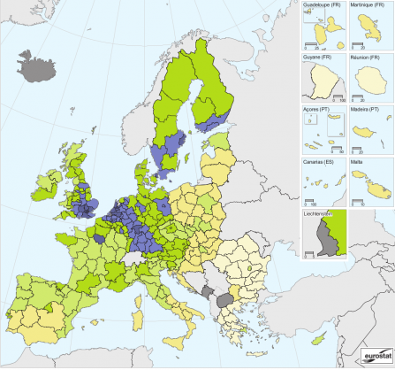
Competitiveness index

Slide 7
The main objective of TechnoBit Venture was to create
15 new enterprises based on innovative ideas
in the following sectors:
Implementation period: 1.05.2009 - 31.12.2014
Budget for investment: 11 million PLN
Number of investments: 15
Furniture
Tourism
IT
Environmental protection
Plastic
Printing
Metal industry
Automation
Electronics
Medical

Slide 8
Statistics ideas:
During the 5 years of TechnoBit Venture implementation 138 ideas were officially registered and rated formally.
More than 200 queries were sent by e-mail and by telephone, concerning the possibility of financing their idea.
138 ideas registered
Queries via telephone
Queries by email

Slide 9
Ideas submitted in the years 2009-2014

Slide 10
Ideas submitted in the years 2009-2014 by type of industry

Slide 11
81% were assessed positively in terms of form
Approx. 37% was positively evaluated in terms of content
Approx. 11% were qualified to investment phase
Among 138 submitted ideas
30% were classified for pre-incubation phase

Slide 13
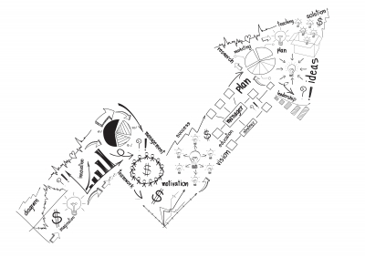
Strategy investment of RDA BB foresees that
no more than 45% of companies would come
from the ICT industry.
So far 33% are companies from ICT industry
Approx. 13% are companies related to medicine, plastics, metal industry (nearly 40%)
The rest of ideas were divided
between the other sectors

Slide 14
Investments by industry

Slide 15
Capital Group of RDA BB (1)
Companies established in the framework of capital investments
1) Multic Technology Sp. z o.o.
2) Injectors Viper Polska Sp. z o.o.
3) System 7 Security Sp. z o.o.
4) Biuro Badawczo-Wdrożeniowe Sp. z o.o.
5) CNC Express Sp. z o.o.
6) Galena Hope Sp. z o.o.
7) Spoimax Sp. z o.o.

Slide 16
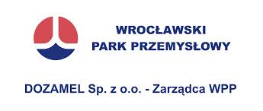
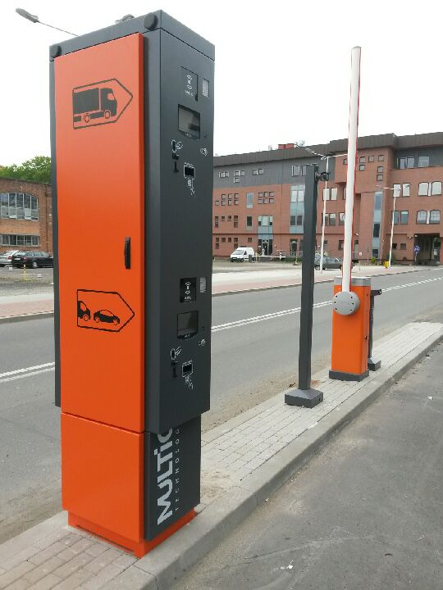
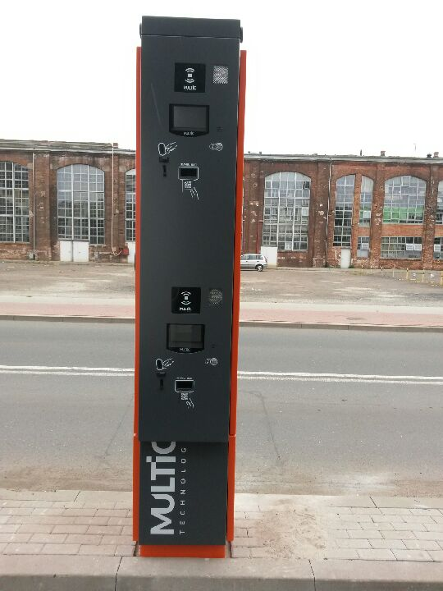
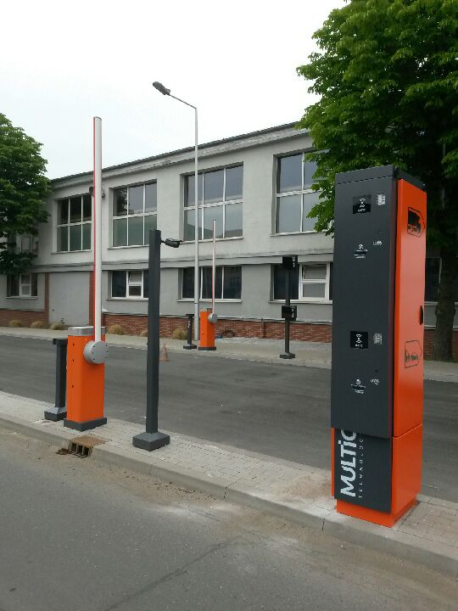

Slide 17
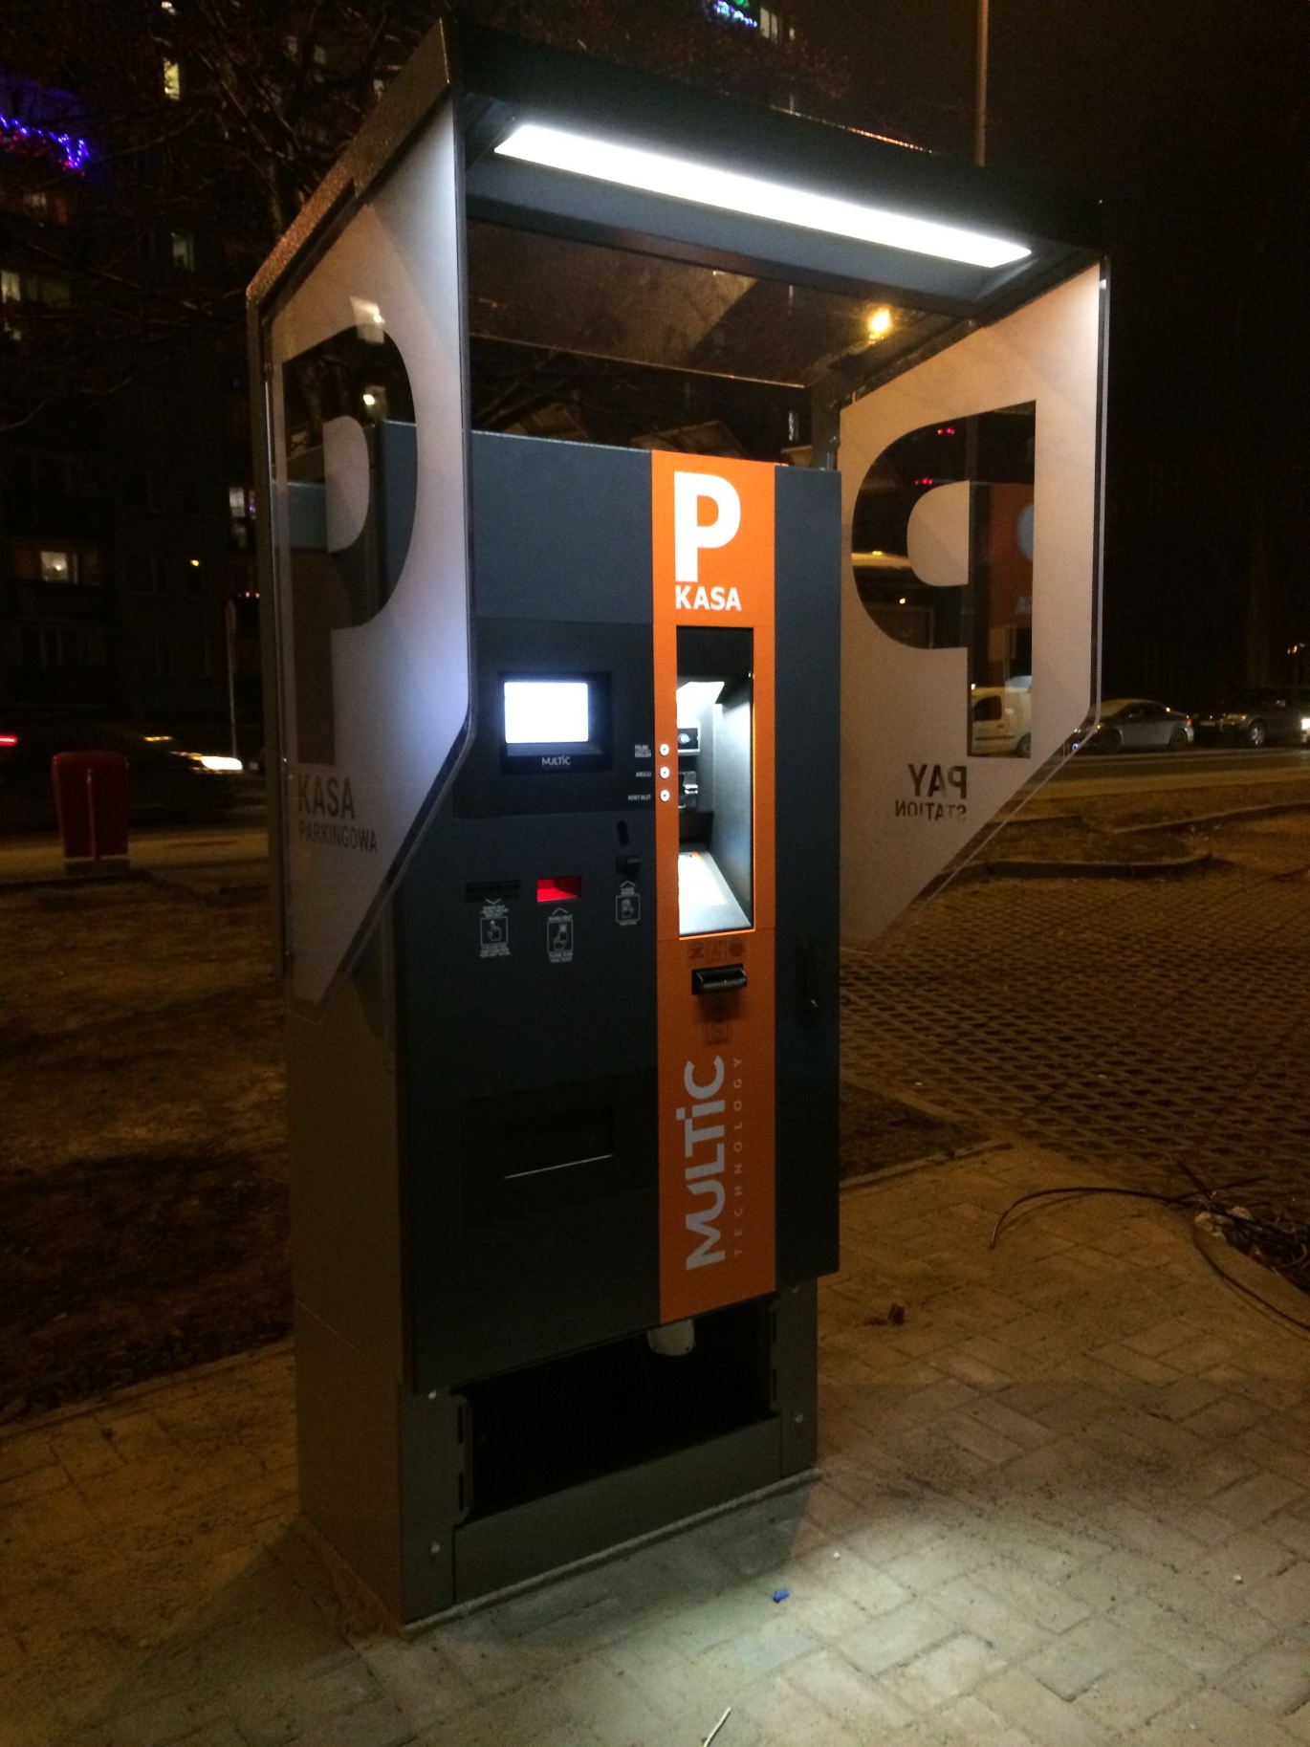
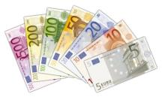
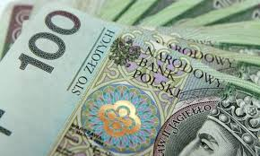

Slide 18
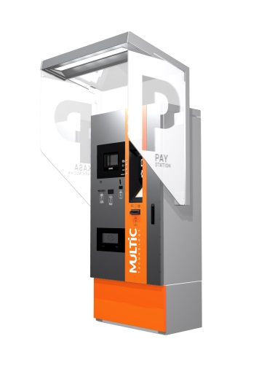
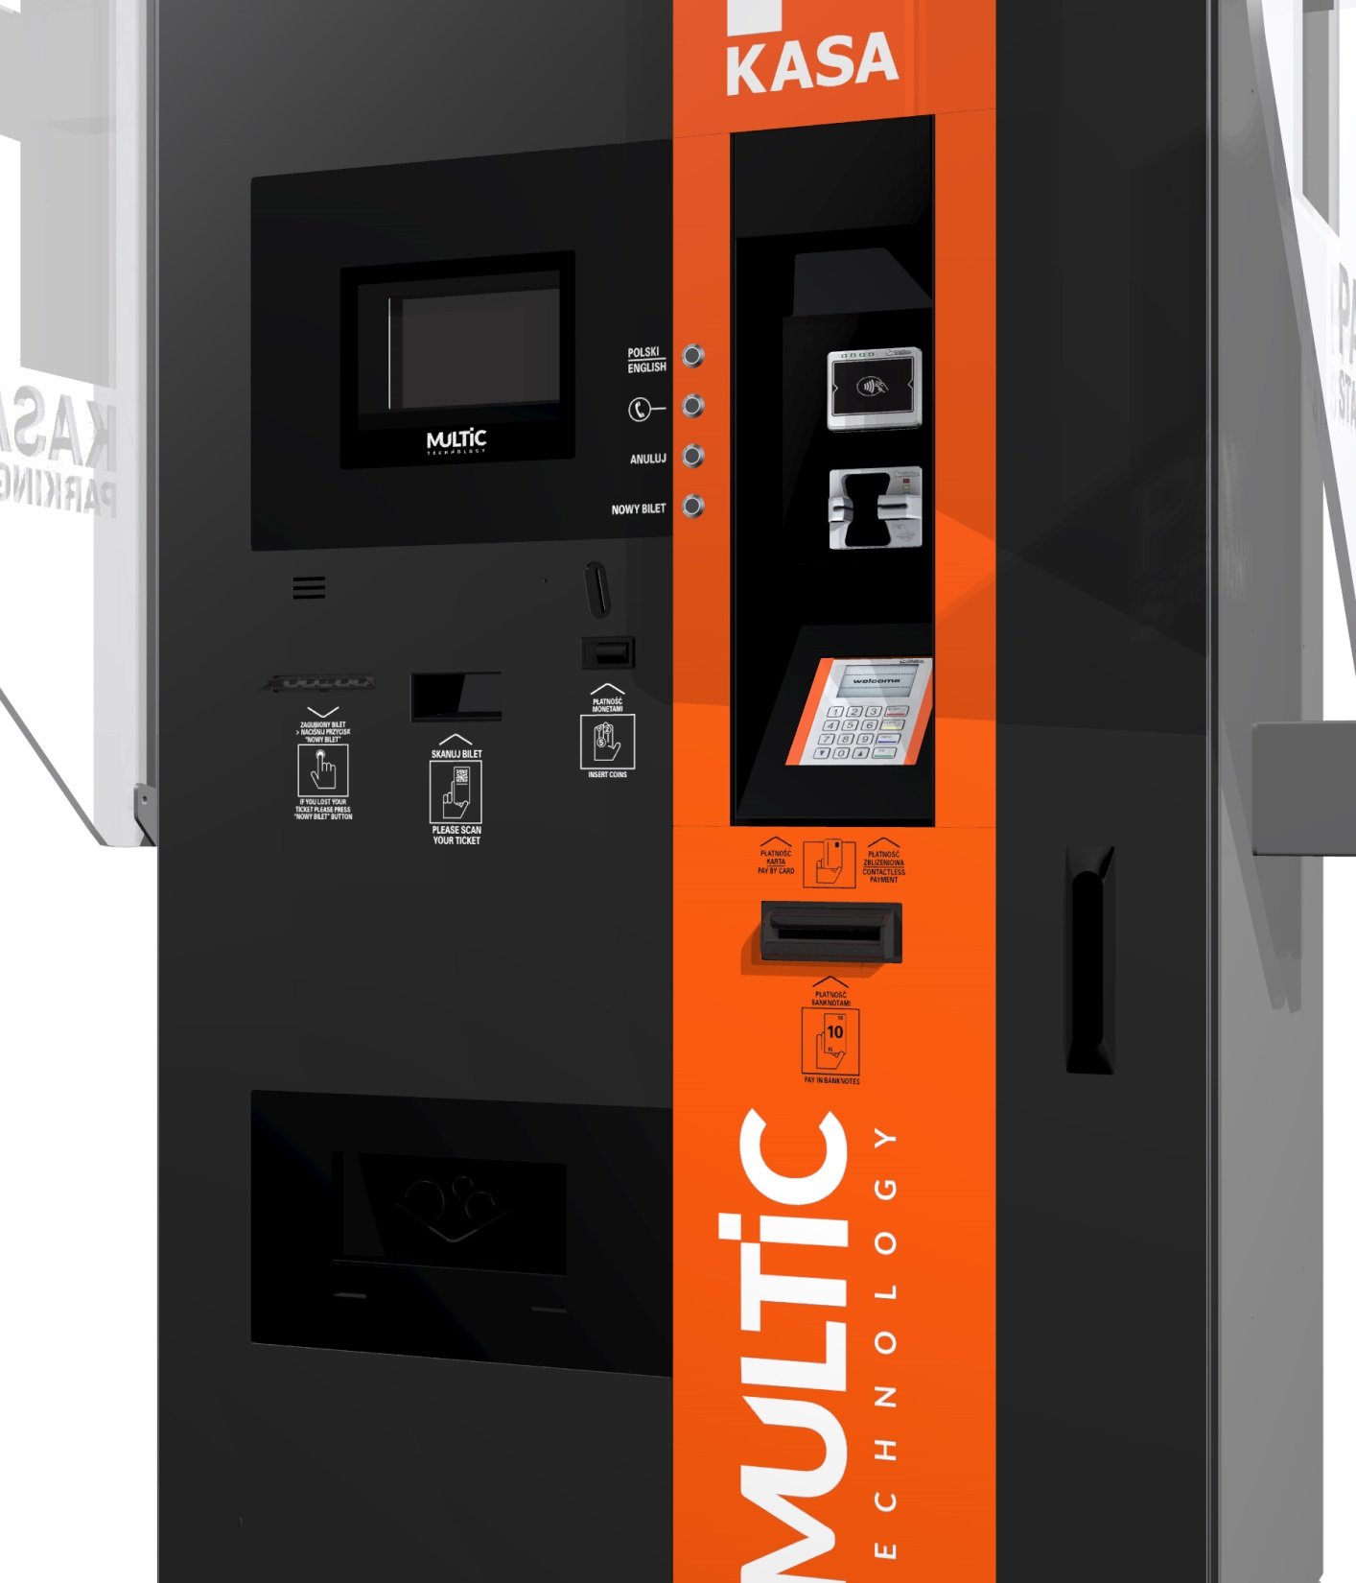
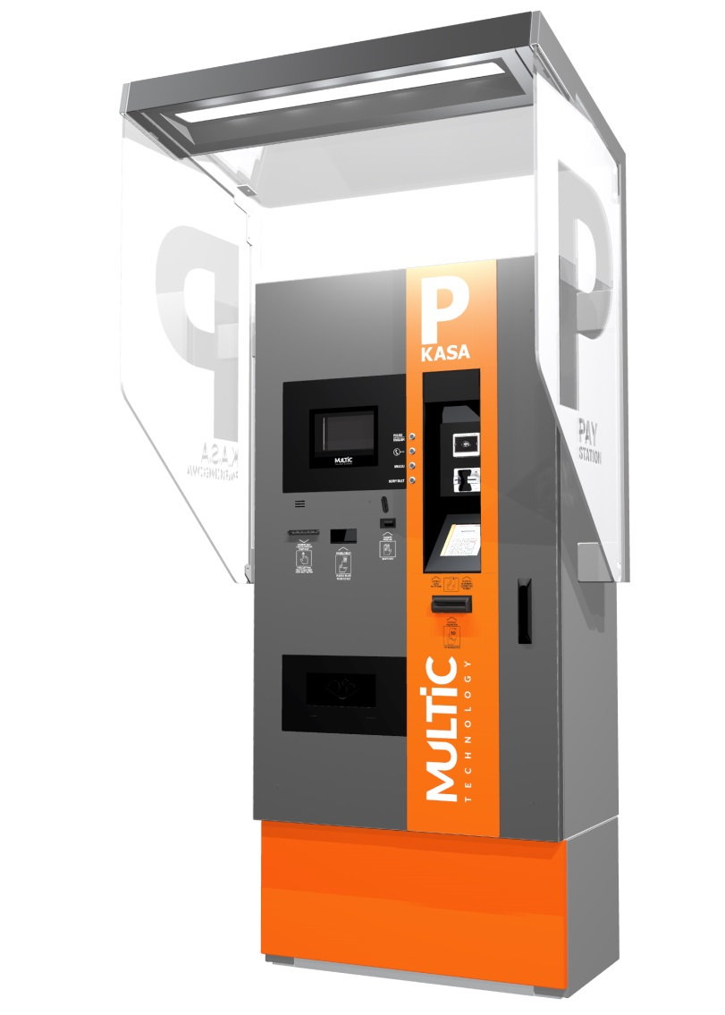

Slide 19
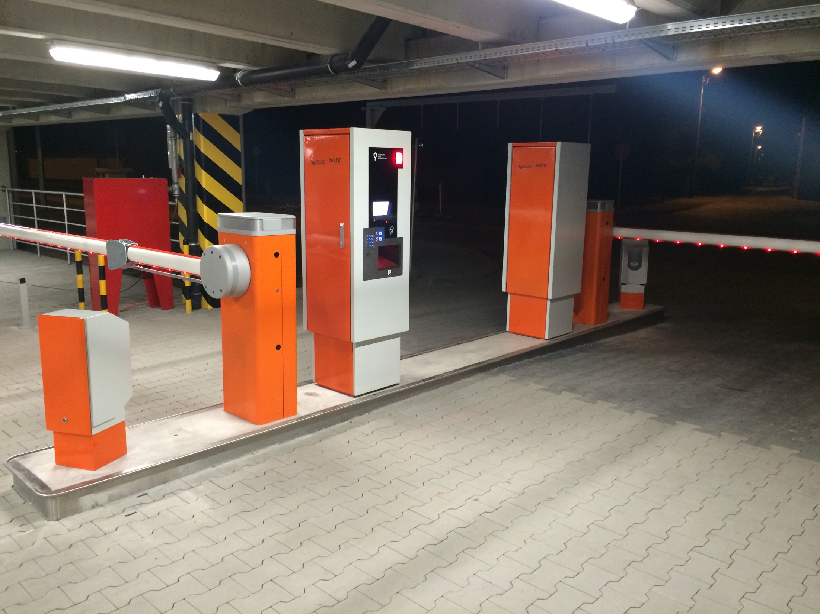
P&R dla MKA
Smart City

Slide 20
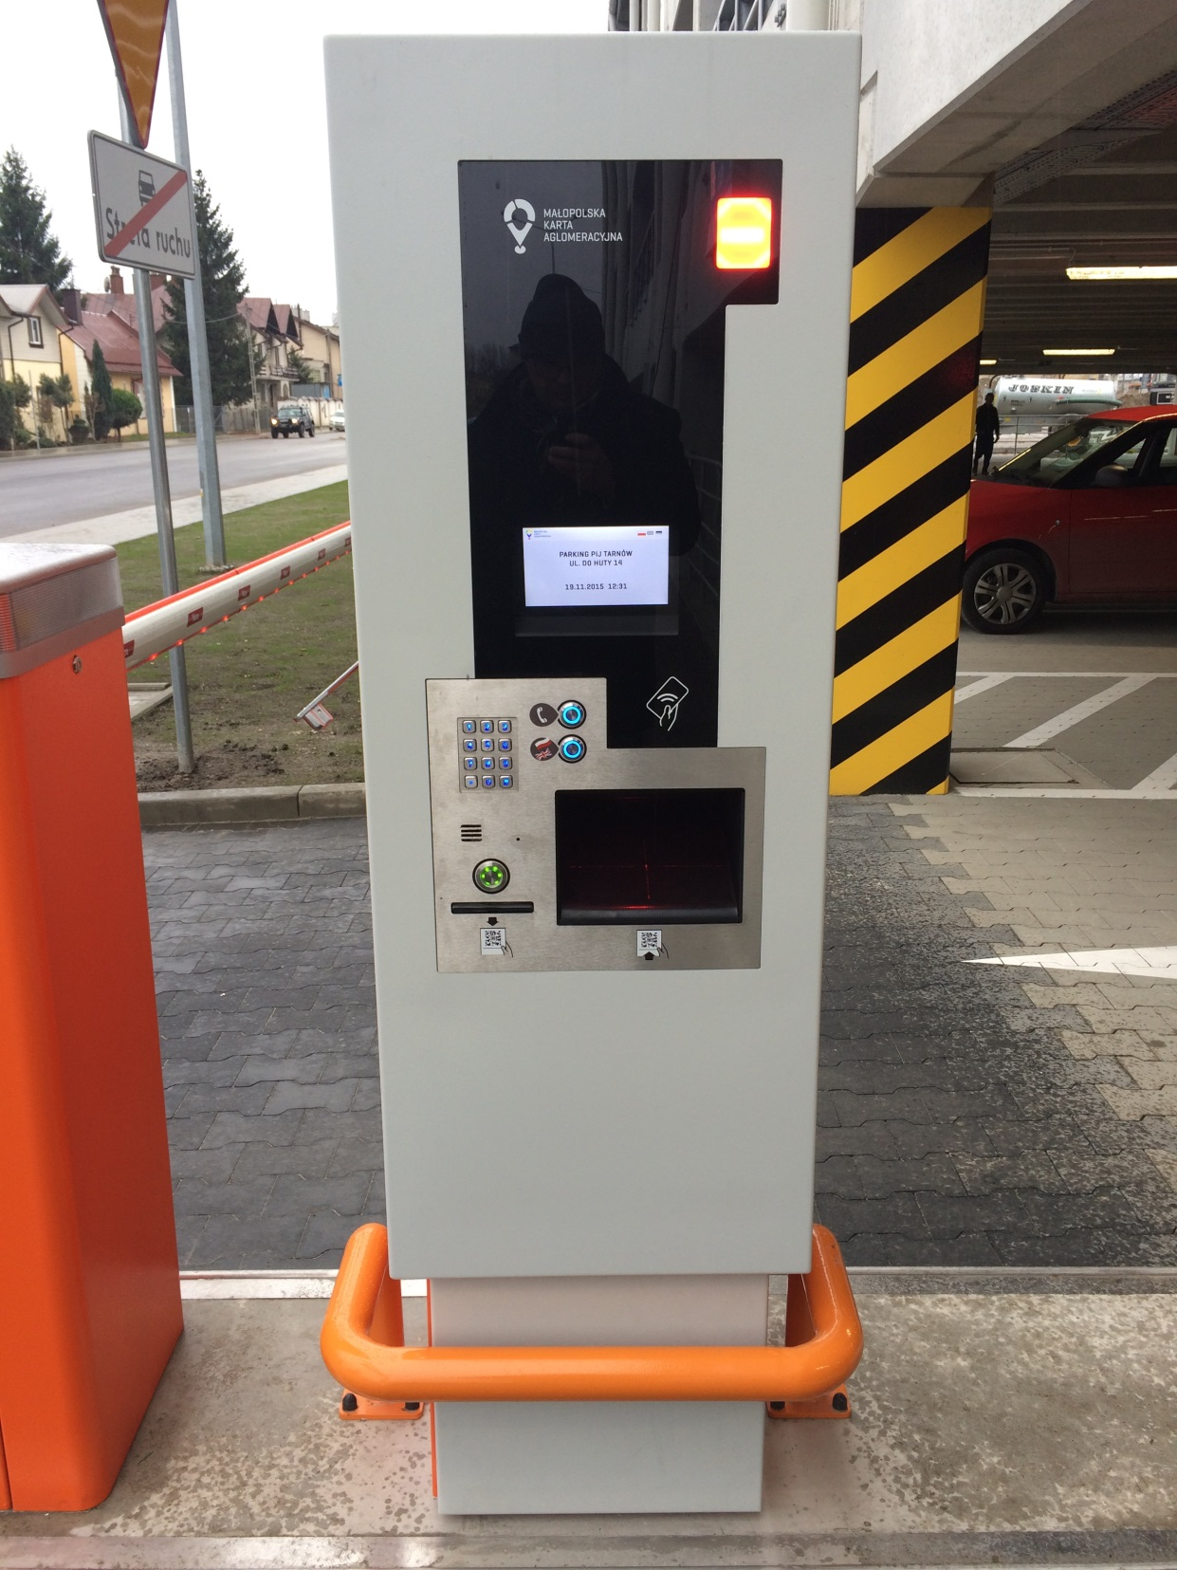
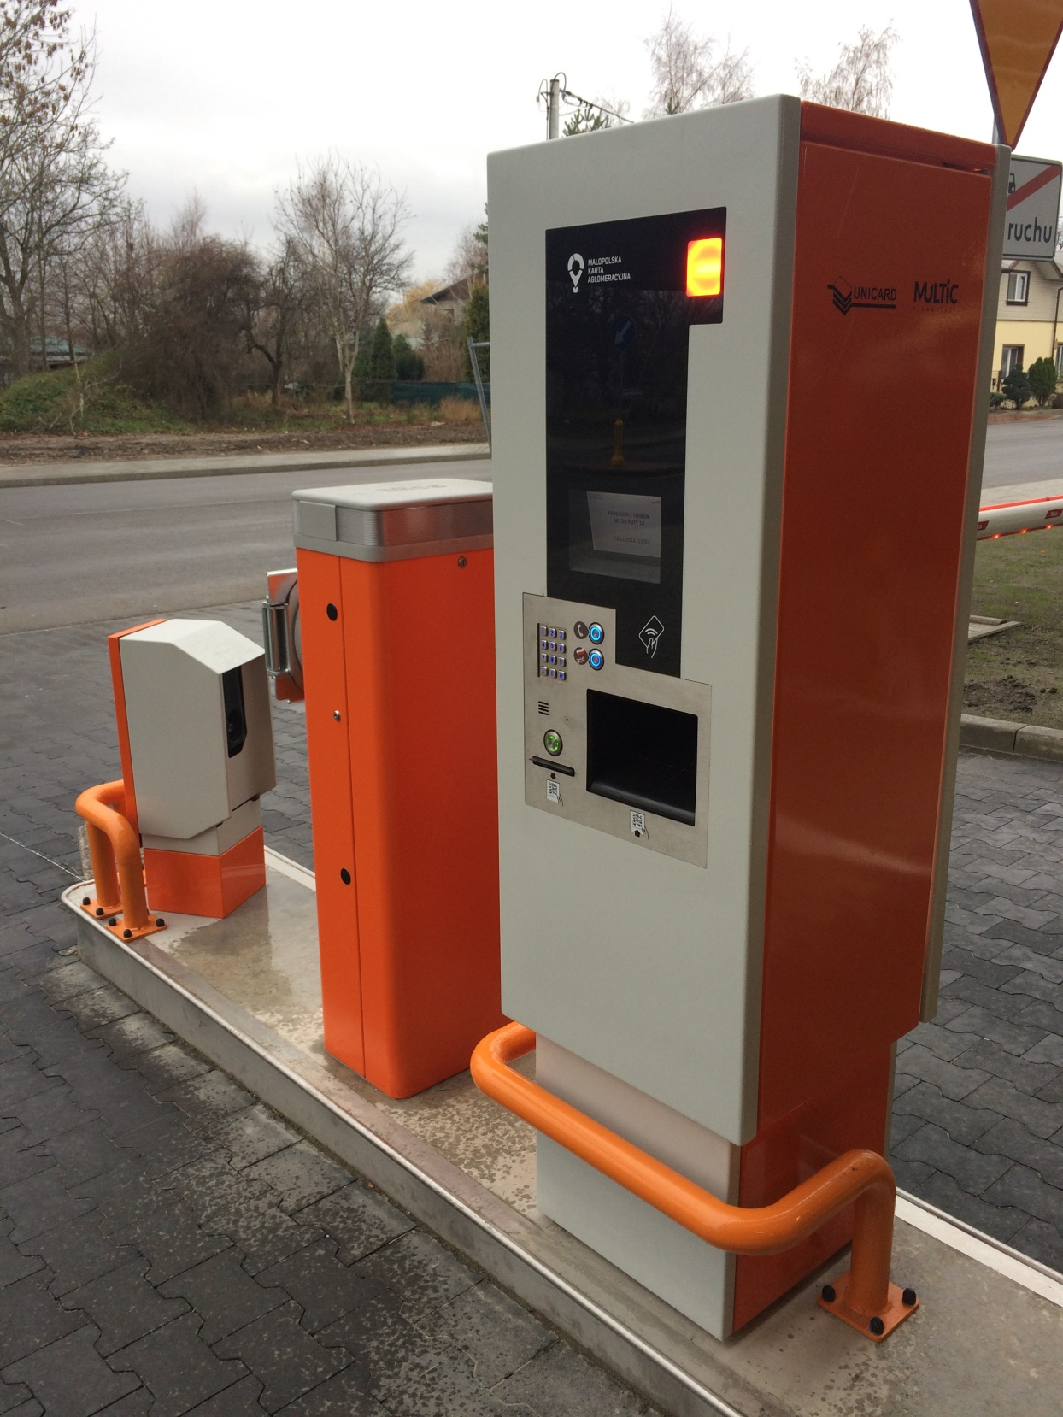

Slide 21
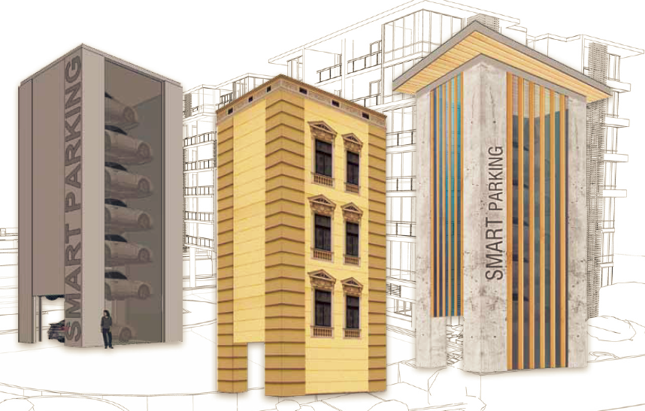
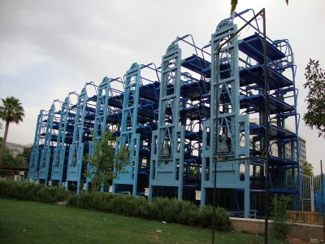
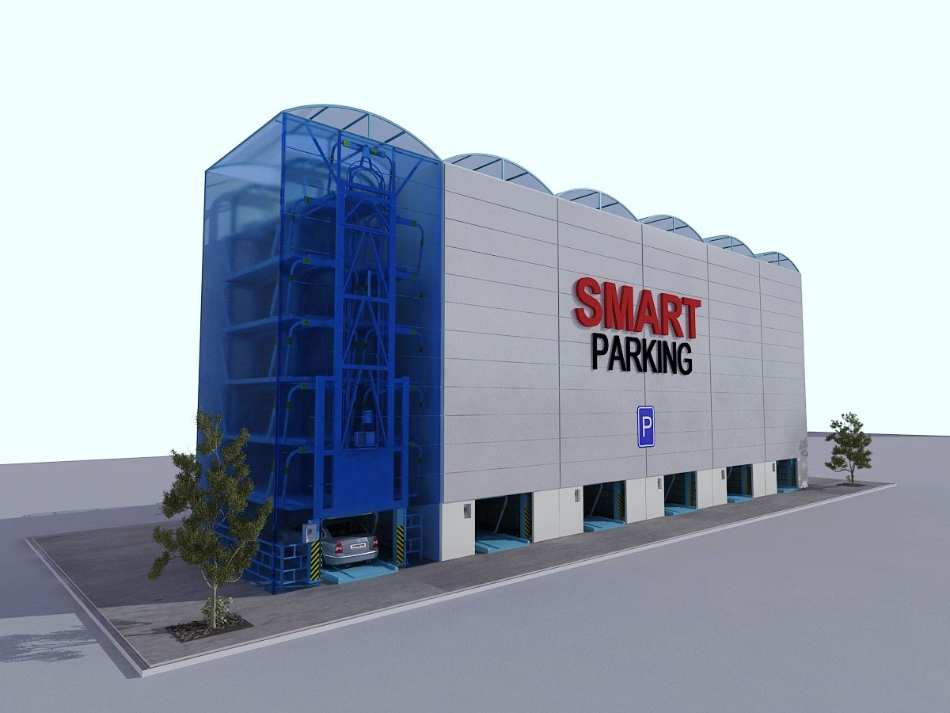

Slide 22
Capital Group of RDA BB (1)
Companies established in the framework of capital investments
1) Multic Technology Sp. z o.o.
2) Injectors Viper Polska Sp. z o.o.
3) System 7 Security Sp. z o.o.
4) Biuro Badawczo-Wdrożeniowe Sp. z o.o.
5) CNC Express Sp. z o.o.
6) Galena Hope Sp. z o.o.
7) Spoimax Sp. z o.o.

Slide 23
Capital Group of RDA BB (2)
Companies established in the framework of capital investments
9) Multi-Net Infrastruktura Sp. z o.o.
10) Controlla Sp. z o.o.
11) CellMedica Sp. z o.o.
12) Recycling System Sp. z o.o.
13) Bielska Fabryka Dźwigów BEFARD Sp. z o.o
14) 3DrukBIT Sp. z o.o.
15) Seven Sp. z o.o.

Slide 24
Initiation of start-up
establishment of 15 start-ups
RDA invested
10.2 mio PLN
starts-ups created ~70 new work places
Returns of investments
new investments
2009 2009-2014 2016-2020

Slide 25
8 companies were created by the payment of the contribution in the form of patents, prototypes, know-how,
5 companies were based on the separation / contribution of the company that owns the innovative idea
Start-ups during the operation have made approx. 15 patents protection of industrial property
INTELECTUAL PROPERTY

Slide 26
Demand for capital
30% of the companies showing interest in obtaining further funds as the second round of financing innovation
The most popular are grants, loans, alternative capital investments
The average value of the expected investment - approx. 1 million PLN

Slide 27
Seed fund - Beskid Accelerator of Technology
Capital exits and return of investment
Continuation of activities in the frame of TechnoBIT Venture project
Management of the companies in the RDA BB capital group

Slide 28
Seed fund - Beskid Accelerator of Technology
Creation: | January 2014
Budget: | depended on investment returns in the period 2014 - 2022, with no time limits
Investment period: | 10 years
Areas of interest: | IT / ICT, medicine, metal industry, environmental protection (including renewable energy), tourism, furniture, printing, plastics, electronics and automation and other

Slide 29
Forms of involvement of RDA in the start-ups companies
Common board (representative of RDA BB)
Board and proxy (representative of RDA BB)
Supervisory board

Slide 30
Key factors from 5 years experience of TechnoBit Venture:
Access to capital
Fund management team - experience in technology transfer, management marketing, initial public offering, intellectual property rights
Pre-incubation - advisory services, coaching, proof of concept
Access to private capital (businness angels)

Slide 31
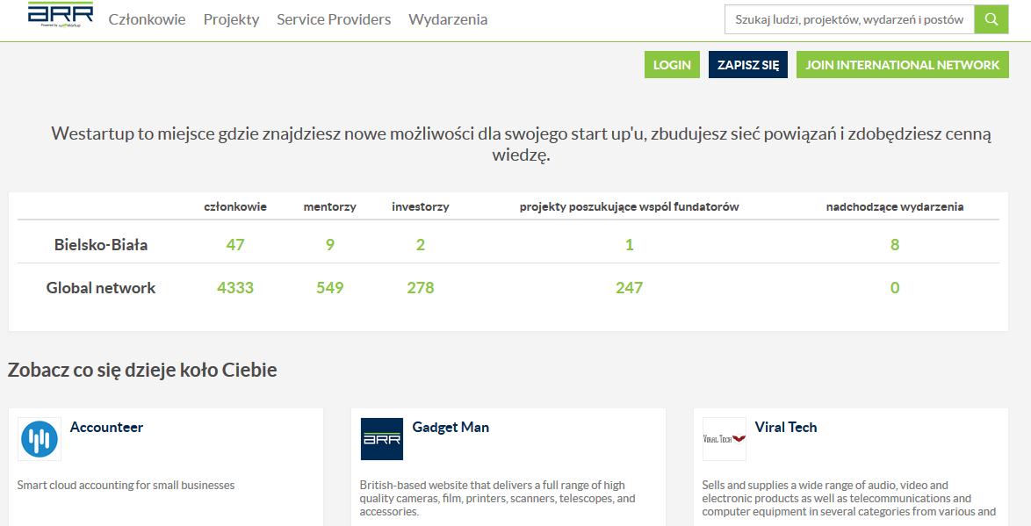
westartup.pl platform

Slide 32
westartup.pl platform

Slide 33
Thank you for Your attention
Stanisław Ginda
Regional Development Agency
Bielsko-Biała

