Slide 1
REIMBURSABLE FUNDS IN JEREMIE
How to manage Regional Funds
Andalusian Agency for Innovation and Development (AGENCIA IDEA)
Stefan Mathesius
(Head of Financial Instruments)
Brussels, 26 May 2015

Slide 2
Agenda
INTRODUCTION AND BACKGROUND
FINANCIAL INSTRUMENTS IN ANDALUSIA
ANALISIS OF ISSUES AND LESSONS LEARNED
2

Slide 3
Key facts about Andalusia
GEOGRAPHIC SITUATION
FACTS ABOUT ANDALUSIA
Population: 8.400.000 (most populated region in Spain)
GDP: 17.000 € (75 % of European average)
Unemployment rate: > 32%
Youth unemployment rate: > 65%
Very strong impact of the economic crisis
Predominant enterprise structure: Micro enterprises and self employment
Main activity / employment Sectors: Tourism, Construction, Agriculture, Public Administration
3

Slide 4
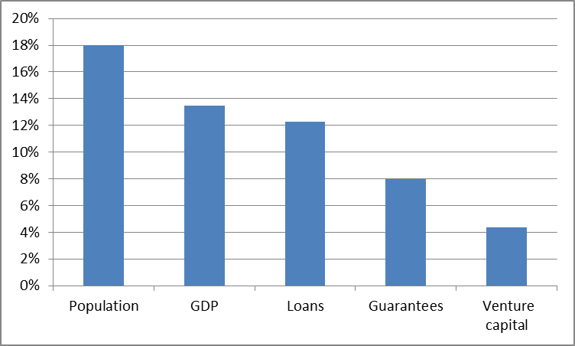
Economic/Financial data of Andalusia
Weight Andalusia / Spain
4

Slide 5
Business lines of IDEA
Regional Ministry of Employment, Enterprise and Commerce
Andalusian Agency of Development and Innovation
300 employees
8 regional delegations
Infrastructures, Productive Spaces and Technology Sectors
Attraction of investments and Advanced Services
Grants
Financing and Business Development
Financial
Instruments
5

Slide 6
Agenda
INTRODUCTION AND BACKGROUND
FINANCIAL INSTRUMENTS IN ANDALUSIA
ANALISIS OF ISSUES AND LESSONS LEARNED
6

Slide 7
Evolution of Financial Instruments managed by IDEA
Millions of €
16
16
10
12
9
9
5
Invested
430 M€
1.450 projects
1
Return (cash)
130 M€
No JEREMIE
JEREMIE
7

Slide 8
Set-up of JEREMIE in Andalusia
Management Authority
(Ministry of the Finance and Public Administrations)
Intermediate Body
(DG European Funds,
Regional Ministry of Economy )
Financing
Agreement
HF Manager
(Andalusian Agency for Innovation and Development)
Regional
Contribution 20%
ERDF
Contribution 80%
JEREMIE
Holding Fund
378 M€
185 M€
50 M€
143 M€
Multiinstrument
(Mezzanine)
Risk Capital
Funds
Sectorial Funds
(Co-investment)
Specialized Intermediary
Risk Capital management companies
Banks
8

Slide 9
Private Leverage mechanisms of JEREMIE
Regional
Contribution 20%
ERDF
Contribution 80%
JEREMIE
Holding Fund
378 M€
185 M€
50 M€
143 M€
Multiinstrument
(Mezzanine)
Risk Capital
Funds
Private Investors (LPs)
Sectorial Funds
(Co-investment)
Specialized Intermediary
Risk Capital management companies
30-40%
Banks
30%
Private investors
(deal by deal)
30-60%
9

Slide 10
Configuration of JEREMIE (Multiinstrument) in Andalusia
Investment approach
Access to finance
Any stage of company (seed, start-up, expansion)
Taylor made financial solutions (ordinary loan, mezzanine loan, equity, guarantees)
Investment ticket: from 0,1 M to 10 M€
Aid scheme
JEREMIE Multiinstrument is implemented without aid scheme
Investments made at market conditions
Private
leverage
Leverage on deal by deal basis (Multiinstrument itself 100% public)
At least 30% private leverage required
On average 70% private leverage obtained (multiplier 3,3)
Results
80% of funds invested by end 2015 (150M€ of 185M€),
90 projects in total (approval ratio of 20%)
Impact: induced investment 460 M€, employment (created or safeguarded): 9.100
Pros & Cons
Personalized solutions with high impact and effectiveness, in particular during financial crisis (2009-2013)
Complex verification process (market conditions), sophisticated investment process
10

Slide 11
Agenda
INTRODUCTION AND BACKGROUND
FINANCIAL INSTRUMENTS IN ANDALUSIA
ANALISIS OF ISSUES AND LESSONS LEARNED
11

Slide 12
What was the Central Problem of JEREMIE in OP 2007-2013
ESI Funds
Financial
Instrument
Final recipient
12

Slide 13
Ecosystem of EU funded Financial Instruments
ESI Funds
Regional Co-funding
Holding Fund Manager
Holding Fund
State aid
Selection process +
Management contracts
Product
design
Leverage
Financial Intermediary
Financial instrument
Private Investors
Management
fees
Investment
process
Closing &
Winding up
Final recipient
Expenses for
the recipient
Verification
= main issues
13

Slide 14
Main issues of EU funded Financial Instruments
Initiation &
Programming
Configuration, Selection & Contracting
Implementation &
operational
management
Monitoring, Control,
Verification
& Closing
Possible changes of priorities over time (economic cycles):
Anticipation in the ex antes assessment
Flexibility in the financing contracts
Approval mechanism (delegation or centralization) congruent to FI and financial intermediaries
With/without aid scheme => impact of FI => complexity/approach of verification
Lead time 6-12 months from configuration to call for proposal / procurement
Conflict between efficiency and effectiveness
Conflict between exigencies (contractual obligations/ limitations, bureaucratic burdens, remuneration) and attractiveness /capability to manage the FI for financial intermediary
Anticipation of problems in the management contracts/ break up clauses
IT systems: clear definition of interfaces between intermediary and HF manager
Agility of Approval procedures
Private leverage
Legal limitation in case of refinancing
Clear definition of documentation (availability, content of “administrative record”)
Mechanisms for contractual adaptions/ modifications
Calibration of the verification criteria. Must be clear from the beginning (management contracts)
Eligibility of expenditures & evidence of achievement of the intended purpose
Monitoring procedures and clear definitions of metrics
Clear winding up clauses an d procedures (to be defined in the management contracts)
Difficulty to break up management contracts (=> impact for private investors + final beneficiary)
14

Slide 15
Lessons learned
Incorporation of aid schemes (de minimis, block exemption) to increase attractiveness for final beneficiary and to facilitate verification.
Standardization of investment criteria and terms & conditions of the financial operations (increases efficiency and facilitates verification, however prejudices effectiveness).
Meticulous preparation and configuration of the financial instrument, procurement and management contracts (PPP) is necessary:
Clarity of terms/conditions/procedures/documentations from the beginning
Any ambiguity bear risks (legal, financial, reputational) for all stakeholders (HF manager, intermediaries, private investors, final beneficiary)
Find balance between flexibility and break-up clauses in case of non performance and strategic changes
Strategic and operational fit necessary between: type of market gap, type of instrument, type of intermediary.
Private leverage, in particular in case of standardized instruments, should be implemented on instrument level and not on deal by deal level (=> facilitates verification and increases efficiency).
15

Slide 16
Thank you for you attention
Stefan Mathesius
Head of Financial Instruments
16

