Slide 1
1.Financial Instruments under
ESIF 2014-2020
2. Synergies between ESIF and EFSI (Juncker Plan)
3. Commission Guidance on Financial Instruments
AGORADA , BRUSSELS, MAY 2016

Slide 2
Overview:all Financial instruments 2014-2020
Centrally managed by COM
(EU FI- Financial Regulation)
Shared Management with MS (ESIF FI - Common Provisions Regulation)
Research, Development Innovation
Horizon 2020
InnovFin (Equity and Risk Sharing Instruments)
Instruments under Structural and Cohesion Funds
Contribution to EU level (central management)
National/regional instruments (shared management)
Off-the shelf FIs
Tailor made FIs
Significantly higher amounts expected than in current MFF!
Growth, Jobs and Social Cohesion
Competitiveness & SME (COSME)
Equity & guarantees
Creative Europe
Guarantee Facility
Social Change
& Innovation
Erasmus for all
Guarantee Facility
Infrastructure
Connecting Europe Facility (CEF)
Risk sharing (e.g. project bonds) and equity instruments

Slide 3
Principles of financial instruments under ESIF
Types of financial instruments
Loans
Guarantees
Equity
Addressing lack of available financing
Providing financing at favourable conditions
Advantages of financial instruments
Leverage effect
Revolving nature
Better quality of projects
Increasing efficiency and effectiveness of EU funding
Ways to implement financial instruments
Tailor made
'Off-the shelf'
EU level
Implementation options allowing for standardisation and customising

Slide 4
2014-2020 ESIF framework
Performance oriented legal framework to promote the use of financial instruments (FI)
Financial instruments are a delivery mode – not an objective
Not all projects (investments) can be supported with FI. The activity must be generating income/revenue/cost savings in order to ensure repayment of investment
Decision to deliver OP support through FI is with the managing authority (MA)

Slide 5
2014-2020 ESIF framework
Key characteristics (1)
Single comprehensive legal framework for all ESI Funds (common interpretation/guidance)
CPR title IV on FIs (9 extensive articles and annexes), DA/IA,
Some elements included in 2007-2013 in COCOF note become legally binding in 2014-2020
FI definitions: operation, beneficiary, final recipient, financial instrument, escrow account, fund of funds
State aid (frequent references in title IV, compliance required for MA/FoF/FI)
Wider scope: Expansion to all thematic objectives & priorities foreseen by ESIF OPs (ERDF, ESF, Cohesion Fund, EAFRD,EMFF).

Slide 6
2014-2020 framework
Key characteristics (2)
Ex-ante assessment to be carried out before launch of FI operation under the ESIF
Incentives regarding EU co-financing rates
Phased contributions to FIs (c.f. guidance note)
More detailed rules concerning
  eligible expenditure at closure,
  the (re-)use of interest/other gains and ESIF resources returned during the programming period,
  the use of interest/other gains and ESIF resources returned after closure (legacy)

Slide 7
2014-2020 framework
Key characteristics (3)
Annual reporting by MAs
  MA to report on FI operations annually, sending to the Commission a more comprehensive set of data.
  Commission to publish annual summary report on the basis of data received.
  Implementation options
  Traditional implementation possible: MA sets up a FI at national, regional, transnational or cross-border level
    Tailor-made instruments
    Standardised “off-the-shelf” instruments
  MA may contribute OP allocation to EU level instrument
  MA may implement loans or guarantees directly without formal set-up of a fund
  SME initiative, guarantees for SMEs implemented by EIB/EIF

Slide 8
2014-2020 ESIF framework
Implementation options
Managing Authority
Traditional implementation:
MA sets up a FI at national, regional, transnational or cross-border level
FI can be implemented with FoFs and without FoFs
Novelty:
Off-the-shelf instruments with standard conditions to facilitate the set–up phase
SME initiative, guarantees to SMEs by EIB/EIF, no national co-financing
Fund of Funds (FoF)
Financial
Intermediary
Financial
Intermediary
Financial products
Financial products
Final recipients
Final recipients

Slide 9
SME initiative
Article 39 of CPR, " Contribution to joint uncapped guarantee and securitisation financial instruments for SMEs , under a dedicated OP implemented by the EIB"
In Spain and Malta, the SME initiative is now operational ( ES : € 800 m, MT: € 15 m)
Bulgaria, € 102 m : intermediaries under selection no
For Italy, € 100 m, and Romania, for € 100 m, both dedicated OPs approved
Finland, € 20 m, dedicated OP under approval
Greece is interested, dedicated OP under preparation

Slide 10
ESIF 14-20: Off-the-shelf instruments-1
Managing Authority
What are off-the shelf instruments?
Financial instruments complying with the standard terms and conditions laid down by the Commission
Help to accelerate implementation
Learn and build on the experience from 2007-2013
Fund of Fund
Key advantages
State aid compatibility
Governance structures
Based market practise
Full pass on of advantage to final beneficiary
Minimum leverage ensured
Fund managed
by financial intermediary
Financial
products
Final recipients
Notes:
The Urban Development Fund shall take the form of a loan fund to be set up and managed by a financial intermediary with contribution from the ESIF programme and contribution of at least 30% of the loan fund from the financial intermediary.
The Urban Development Fund shall finance and support implementation of urban development projects in assisted areas, as well as mobilise co-investment from private sources, including among others the financial intermediary's co-financing.
In order to address high concentration of economic, environmental and social problems of urban areas located in assisted areas identified in a regional aid map, an urban development fund may be an appropriate financial instrument.
The urban development fund mobilises co-investment from private investors to support implementation of urban development projects and aims to addressing market failures by supporting sustainable urban development strategies, in a context of limited availability of funding or relatively low appetite of the financial intermediaries for supporting urban development projects.
‘assisted areas’ means areas designated in an approved regional aid map for the period 1.7.2014 - 31.12.2020 in application of Articles 107(3)(a) and (c) of the Treaty.

Slide 11
ESIF Financial instruments 14-2020: "Off-the-shelf instruments -2 "
Three for SMEs
Loan for SME's based on a portfolio risk sharing loan model
(Risk Sharing Loan).
Guarantee for SMEs (partial first loss portfolio,
capped guarantee).
Equity fund for SMEs and start-up companies based on a co-investment model (under approval).
One for energy efficiency/renewable energies and one for urban development
Renovation Loan based on a Risk sharing loan model (RS Loan).
Urban Development Fund (under approval).

Slide 12

Horizontal assistance
  platform for advisory services on financial instruments under ESIF and EaSI (micro-finance)
  provided by the European Commission in partnership with the European Investment Bank
  designed to support managing authorities and other interested parties
  providing practical know-how and learning tools on financial instruments, newsletter, case studies, reference twxts
  National events (presentation of case studies, discussion of technical questions, hands-on workshops)
  Please Register in www.fi-compass.eu

Slide 13

Investment Plan for Europe: 3 pillars
1. MOBILISING FINANCE
FOR INVESTMENT
2. MAKING FINANCE
REACH THE REAL ECONOMY
Mobilise at least €315bn over 3 years for investment in strategic projects and access to finance via the European Fund for Strategic Investments (EFSI) within EIB/EIF
Cooperation with National Promotional Banks
European Investment Project Portal
European Investment Advisory Hub: technical assistance
3. IMPROVED INVESTMENT ENVIRONMENT
Predictability and quality of regulation
Removing non-financial, regulatory barriers
in key sectors within EU Single Market
Structural reforms at national level
Notes:
The purpose of this slide is to:
present the rationale for launching Investment Plan for Europe (under-investment in Europe)
refer to the date of its announcement and the date of adoption of EFSI regulation
present the structure of Investment plan for Europe
___________________________________________
1. Investment plan for Europe aims to address the current under-investment in the EU (still 15% below the pre-crisis level)
2. The Investment Plan for Europe (IPE) was announced on 26 November 2014 (see COM(2014)903 final). EFSI Regulation was adopted on 25 June 2015 (Regulation (EU) 2015/2017)
3. It is important to highlight the three-pronged approach of the Investment Plan for Europe:
making available finance for investment: a new vehicle is created to crowd in private investors: EFSI – European Fund for Strategic Investments
Helping finance to reach projects by preparing projects (via the newly created European Investment Advisory Hub – EIAH) and by providing a platform to present projects to attract investors (European Investment Project Portal – EIPP).
Improving the investment environment through removing barriers and inducing structural reforms

Slide 14
ESI Funds contribution
to the Investment Plan for Europe
COMPLEMENTARITY:
ESIF / EFSI
1. Mobilising finance for investment
Better use of ESI Funds
≥ EUR 20 bn additional investment through FI for 2015-2017
SMEs Research
Transport Environment
2. Making finance reach the real economy
Technical Assistance
JASPERS
FI-Compass
Programme funding for project preparation
3. Improved investment environment
Ex-ante Conditionalities
Notes:
The purpose of this slide is to:
Underline that ESI Funds contribute to all three pillars of the Investment Plan for Europe.
___________________________________________
ESI Funds contribute to delivering on all three pillars of the investment plan:
Finance: 450bn are available under ESI Funds for 2014-2020; a more efficient and effective use of funds shall be achieved through enhanced deployment via financial instruments. It is an explicit objective by the Commission to at least double the use of FI in 2014-2020 compared to the previous period.
Technical Assistance: JASPERS and fi-compass are existing programmes up and running under EIAH. Moreover, also under ESI Funds programmes part of programme funding will be used for project preparation.
Investment environment: ex-ante conditionalities require MS to have certain pre-conditions in place before ESI funds will be available.

Slide 15
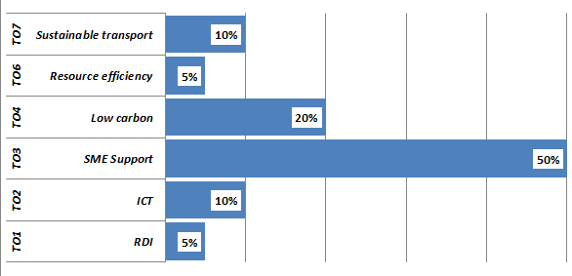
ESI Funds Financial Instruments – doubling the use
Resource-efficient way of using EU budget funds to enable investment in the economy - through loans, guarantees, equity, venture capital, etc.
2014-2020
What's New?
Regulation: FI extended to ALL thematic objectives and all ESIF funds
Additional support:
FI Compass - advisory service
"Off-the Shelf" Instruments
INDICATIVE TARGETS
At least an overall doubling of the use of FI (EUR 12bn to ± 30bn)
Increased leverage effect
Notes:
The purpose of this slide is to:
underline that new ESIF framework was designed with the aim to promote use of FIs
present shortly the current state of play as regards use of FIs in 2014-2020
refer to additional support by COM
___________________________________________
The new framework for ESIF in 2014-2020 was conceived with the clear aim of encouraging an increased use of financial instruments to deliver cohesion policy. A comprehensive legal framework, common to all ESI Funds was set up. Use of FI was made possible to all TOs. The objective to promote use of FIs was reinforced with the launch of the Investment Plan for Europe in November 2014. Nevertheless, experience from implementation of 2014-2020 operational programmes so far demonstrates that more could still be done.
Financial instruments have by nature a longer lead-in and set up time, but our assessment shows that the political target set by the Investment Plan for Europe to at least double the use of financial instruments in 2014-2020 is on its way to be achieved: around EUR 20 billion foreseen so far as opposed to EUR 11.5 billion in 2007-2013 and 7.4 % of ERDF and CF resources (i.e. higher than the 3% average cited for the EU budget as a whole). Furthermore, stakeholders are now starting to implement financial instruments on the basis of the new legislative framework.
Efforts have already been made to provide support to managing authorities in implementing financial instruments through the fi-compass advisory hub, through an extensive set of guidance at the request of managing authorities and through so-called 'off-the-shelf' instruments, ready-made sets of standard terms and conditions for financial instruments in compliance with ESIF and state aid legislative frameworks. However, further work will be needed during 2016 and 2017 to maximise possibilities for use of financial instruments during this programme period.

Slide 16
European Fund for Strategic Investments (EFSI)
EFSI shall mobilise EUR 315 bn in 3 years (15x leverage), under an EU guarantee of EUR 21 bn, implemented via two components:
  an Infrastructure and Innovation Window (IIW) through EIB to support investments of EUR 240 bn
  an SME window (SMEW) through EIF to support investments of EUR 75 bn
Notes:
The purpose of this slide is to:
Present the financial envelope of EFSI and its envisaged impact
Present two components of the EFSI
___________________________________________
EFSI was launched to help overcome the investment gap in the EU by mobilising private financing for strategic investments. EFSI is a risk-bearing capacity of EUR 21bn guaranteeing financing operations by the EIB Group (consisting of a EU guarantee of EUR 16 bn and EIB own contribution of EUR 5bn). The EFSI guarantee should generate in the next 3 years 315 bn investments in Europe, achieving a leverage of 15.
EFSI will be implemented by two components:
infrastructure and Innovation window - implemented by EIB
SME window – implemented by EIF

Slide 17
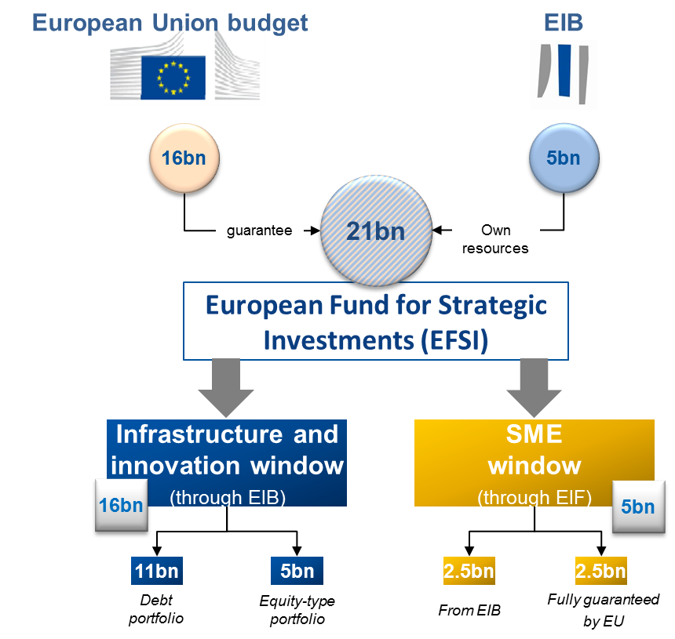
EFSI - structure and investment target
Total EIB/EIF financing
49bn
12bn
Total investment mobilised
240bn
75bn
Notes:
The purpose of this slide is to:
Present the structure and flow of resources in a graphical form
Present the leverage (multiplier) effect (the speaker does not need to present the calculation in detail, but he/she needs to be aware how the numbers are calculated)
If needed defend that envisaged leverage of 15 is a feasible and rather prudent estimate.
___________________________________________
EFSI amounts to EUR 21 bn which consists of: EU guarantee (from EU budget) of EUR 16 bn and EIB own resources of EUR 5 bn. EFSI budget of EUR 21 is split between two components: Infrastructure and Innovation Window (EUR 16 bn) and SME Window (EUR 5 bn).
Under respective windows:
EIB with EUR 16 bn, through debt portfolio and equity portfolio will generate financial activities for EUR 49 bn. These financial activities should result in total investment in projects of EUR 240 bn.
EIF with EUR 5 bn, through its financial activities (guarantees, equities), will generate financial activities for EUR 12 bn. These financial activities should result in total investment in projects of EUR 75 bn.
In total: investment of EUR 315 bn is expected.
As regards leverage (multiplier ratio) it shows how much additional funding EFSI has generated. It is calculated by dividing the total funding achieved by the originating funding (EFSI).
Infrastructure and innovation window:
The leverage achieved at the level of EIB (the internal leverage) equals to 3 (with EUR 16bn EIB will generate activities of EUR 49 bn, i.e. 3 times more). Leverage at the level of projects (an external leverage) equals to 5 (with EUR 49 bn financial activities by EIB a total investment of EUR 240 bn will be achieved, i.e. 5 times more). Total leverage is 15 (with initial EUR 16 bn the total investment of EUR 240 bn is achieved, i.e. 15 times more).
SME window:
The leverage achieved at the level of EIF (the internal leverage) equals to 2.5 (with EUR 5bn EIF will generate activities of EUR 12 bn, i.e. 2.5 times more). Leverage at the level of projects (an external leverage) equals to 6 (with EUR 12 bn financial activities by EIF a total investment of EUR 75 bn will be achieved, i.e. 6 times more). Total leverage is 15 (with initial EUR 5 bn the total investment of EUR 75 bn is achieved, i.e. 15 times more).
The multiplier effect of 1:15 is a prudent estimate, based on historical experience from EU programmes and the EIB. As a reference, the capital increase of the EIB in 2013 had an estimated multiplier effect of 1:18. Likewise, in the context of the current Loan Guarantee Facility for SMEs under the COSME programme, € 1 billion of funding results in at least € 20 billion being available on average on the ground for SMEs, the equivalent of a multiplier effect of 1:20.
The multiplier effect in the individual case will depend on the mix of activities and the specific features of each project. Some operations will have a higher or lower multiplier effect.

Slide 18
EFSI features
EFSI is not a financial instrument (as per CPR or FR)
EFSI support takes the form of FI products (no grant support)
EFSI has its own governance: Steering Board (3 EC + 1 EIB) and Investment Committee (independent entity granting the EU guarantee)
EFSI will offer advice to project promoters through a dedicated advisory hub (EIAH)
EFSI has no geographical or sectorial allocations
EFSI, through EIB, will support high risk profile projects or projects bringing additionality
Notes:
The purpose of this slide is to present the main characteristic of EFSI, in particular:
Its status
Its governance
Its advisory element
Its eligibility
Its value added and project profile
___________________________________________
EFSI is not classified as financial instruments under CPR nor under financial regulation. Nevertheless, it will operate as a guarantee supported by the budget of EU. Support from EFSI will take the form of financial products (no possibility for grants!)
EFSI has its own governance which is different to the governance of ESI funds programmes.
EFSI is supported from the second pillar by the European Investment Advisory Hub offering advice to project promoters.
With EFSI support, the EIB Group provides financing for economically viable projects, including projects. Emphasis is put on the following key sectors: (i) transport, energy and the digital economy; (ii) environment and resource efficiency; (iii) human capital, culture and health; (iv) research, development and innovation; (v) support to SMEs and Mid-Caps. There are no geographical eligibility criteria.
EFSI should support projects with a higher risk profile than ordinary EIB activities.

Slide 19
ESI Funds: key features
ESI Funds = five funds
Delivery through nationally co-financed multi-annual programmes
Form of support: grants or financial instruments
In 2014-2020: €454bn in 500 programmes
Implemented by Member States and their regions under shared management
ESI Funds have geographical and sectorial eligibility criteria as stipulated by the programmes
Notes:
The purpose of this slide is to present to the audience ESI Funds and their main characteristic, in particular:
ESI Funds framework
Strategic, long-term character of support
Allocations
Mode of implementation
Eligibility
In case of presentation to MAs these elements should be only shortly recalled (for ESIF external audience more explanations might be necessary).
___________________________________________
The European Structural and Investment Funds (ESI Funds) is a common designation for five European funds: the European Regional Development Fund (ERDF), the European Social Fund (ESF), the Cohesion Fund (CF), the European Agricultural Fund for Rural Development (EAFRD) and the European Maritime and Fisheries Fund (EMFF), which operate under a common framework (i.e. the CPR) as well as under fund-specific regulations.
ESI Funds upport is programmed for 7 years (10 year implementation) and embedded in multiannual programmes adopted by COM decision. Support under programmes is delivered through different forms of support, mainly: grants and financial instruments.
ESI Funds are important contributors to the EU goals of smart, sustainable and inclusive growth. Volume of ESI Funds is determined in the MFF for the period 2014-2020. Over the 2014-2020 period, €454 billion will be invested in 500 programmes and targeted at strategic, growth-generating areas, primarily in Research, Development & Innovation, support to SMEs, the low-carbon economy, and Information and Communication Technologies.
You may want to refer to your country allocations and give more details on particular MSs envelop.
It is important to underline the implementation mode of ESI funds programmes. They are managed in shared management which implies that programme implementation is in hand of MSs. Important to underline that COM has no role in implementation or selection of projects/operations. Managing authorities are responsible for selecting, implementing and monitoring projects supported by ESI Funds.
ESI Funds programme support must be delivered in line with eligibility rules (geographical and sectorial). Eligibility rules stem from CPR, fund specific regulations and ESIF programmes. National eligibility rules play an important role.

Slide 20
ESIF-EFSI complementarities
Legal bases of both ESIF and EFSI allow for contributions to support each other's objectives (complementarity element)
Their combination is also possible: at project level, financial instrument level and through investment platforms
Implementation process has to respect applicable rules (CPR v EFSI Regulation)
State aid rules apply on a case-by-case basis
Notes:
The purpose of this slide is to:
Refer to the legal possibility of co-investments by ESIF and EFSI
Distinguish between complementarity and combination
Recall the necessity to respect relevant rules
Refer to State aid
___________________________________________
EFSI regulation explicitly refers to the ESI Funds and the possibility to support each other's objectives. ESI Funds framework (CPR) adopted in 2013 does not refer explicitly to EFSI (as EFSI was created after the CPR). The CPR howevert provides for the possibility of combining support by ESI Funds operations with other instruments supported with EU budget. These funds have been designed in a different way but are complementary in terms of rationale, design, and legislative framework. They reinforce each other.
It is important to underline the concept of "complementarity": ESI Funds and the EFSI can collectively target and invest in the same sector/thematic objective safeguarding implementation of comprehensive and integrated investment policy. The projects respectively supported by ESIF or EFSI will complement each other and reinforce investment impact in particular sector. In additional to this "sectorial complementarity" both instruments may target the same geographical area and ensure reinforced and faster investments (even of different type and in different sectors) in a particular region.
Combination can be seen as a sub-set of complementarity. It takes place when ESIF and EFSI either invest collectively in the same project or both use the same delivery mechanism for their support (the funds physically meet at certain level of delivery of support – however they are not blended). The purpose of such combination is to mobilise additional investments through attracting more private investors. Combination is possible in several ways. We will show several illustrations/examples in a minute.
As regards eligibility criteria, any project may be eligible for funding from both the EFSI and the ESI Funds that is economically viable, has a potential to benefit growth and jobs in the EU and is in line with EU priorities for investments. For ESI Funds support specific eligibility criteria apply (as laid down in programmes etc.).
A word on state aid:
The EFSI does not constitute State aid and is not subject to EU State aid rules. ESI Funds provided to businesses, unless granted on market terms, may entail State aid, which is subject to EU State aid rules. The Commission will assess ESI Funds entailing State aid on the basis of its modernised State aid framework. To facilitate the deployment of the EFSI, the Commission will assess the compliance of ESI Funds with State aid rules as a matter of priority and give it fast-track treatment.

Slide 21
National Promotional Banks (NPBs)
NPBs are entities mandated by Member States to carry out development or promotional activities
NPBs hold a significant financing and advisory role in their constituencies – they "know" the local projects
Member State participation under EFSI can be done through NPBs (8 MS already committed)
NPBs may also receive EIB or other support
NPBs' participation mode to be defined by EIB
Notes:
The purpose of this slide is to:
Underline the role and value added of NPBs
Point out the possible involvement of NPBs in EFSI
Refer to EIB group role in exploring new models of cooperation with NPBs
___________________________________________
The EFSI regulation underlines the important role and contribution of NPBs in the delivery of the investment plan due to their complementary product ranges and geographic reach. It should be underlined:
The role of NPBs in MSs development policy.
The knowledge of the market and products.
Possible involvement in delivering FIs under CPR (thus knowing also CPR rules)
NPBs could contribute to EFSI at three levels:
At EFSI level, i.e. contributing directly to EFSI in cash or with guarantees [N.B. no NPB has done so]
Participation in investment platforms as sponsors/investors or implementing entities;
Participation in individual EFSI financed projects as co-financiers.
The July 2015 Commission Communication on the role of NPBs in supporting the investment plan for Europe (see COM(2015)361final of 22 July 2015) underlines their important role and encourages the EIB group to explore opportunities to develop new modes of enhanced cooperation and products. Synergies between the EIB Group and the NPBs can be envisaged across the entire project cycle including technical due diligence.

Slide 22
Investment Platforms (IPs)
IPs are ad hoc vehicles by which financing is channelled to projects
IPs may be set up through various legal structures (SPVs, managed accounts, other arrangements)
They can have a geographical, product, sectorial dimension
IPs may also receive EIB or other support (Member State, private investors)
IPs participation mode to be defined by EIB
Notes:
The purpose of this slide is to:
Present Investment Platform as a delivery mechanism for support to portfolio of projects
Present different types of IP (geographical and sectoral focus)
Indicate their role in attracting co-investors and other stakeholders
___________________________________________
The EFSI Regulation places significant emphasis on the role of Investment Platforms within EFSI as a tool for pooling investment projects with a thematic or geographic focus. Investment Platforms are co-investment arrangements structured with a view to catalysing investments in a portfolio of projects (as opposed to individual projects) with a thematic or geographic focus. Investment Platforms are a means to aggregate investment projects, reduce transaction and information costs and provide for more efficient risk allocation between various investors.
Platforms can benefit from EIB Group EFSI financing under both the Infrastructure & Innovation (“IIW”) and SME window (“SMEW”).
The Platforms can cover a wide range of possible geographical scope of related projects:
A national Platform (single-country Platform) supports projects on the territory of a single Member State;
A multi-country Platform supports projects situated in a group of Member States and non-EU Member States. A Platform could cover the whole of the EU (all 28 Member States);
A regional Platform supports projects in a given region within a single Member State;
A multi-regional Platform would support projects in several regions, either in a single Member State or in several different Member States.
The Platforms can have a pre-defined thematic (sectorial) focus, supporting the eligible objectives under the EFSI Regulation (Art. 9). Platforms could have either:
i. Mono-sector focus, e.g. "energy efficiency" or "renewable energy generation" or "broadband", or
ii. Multi-sector focus, e.g. "social infrastructure investment and energy efficiency"
Since Investment Platforms comprise a wide variety of products, it makes them an attractive tool to respond to market needs. Well-designed Investment Platforms have the potential to attract investment from and to combine resources from different parties, in particular NPBs, institutional investors and Sovereign Wealth Funds (SWFs), and thus boost the leverage and impact of EIB Group EFSI financing.
Investment Platforms can, where appropriate, bring together co-investors, public authorities, experts, education, training and research institutions, the relevant social partners and representatives of the civil society and other relevant actors at EU, national and regional levels. This may take place within existing fora, e.g. macro-regions, networks, stakeholders groups.

Slide 23
ESIF and EFSI combination
Examples presented in
the Brochure on ESIF/EFSI synergies and complementarities published
in February 2016
Notes:
Some general ground rules:
If combined, the use of ESI Funds has to be in line with the eligibility criteria and policy objectives of the originating programme. CPR rules continue to apply (e.g. as regards double funding, preferential remuneration, ex-ante assessment etc.)
ESI Funds programme resources cannot be transferred directly to the EFSI.
Given its nature and structure, EFSI support to a project cannot count as national co-financing of an ESI Funds programme. However, national co-financing of an ESI Funds programme could still be provided through another EIB/EIF financial product, either through a Structural Programme Loan or through intervention at project level. It is also possible that, under certain circumstances, any additional resources leveraged and triggered by the combined ESI Funds and EFSI interventions could be treated as national co-financing for the ESI Funds programme.

Slide 24
grant
ESIF and EFSI combination –
Project level
Other investor
EFSI support
ESI Funds
programme
PROJECT
Notes:
In this type of combination ESI Fund programme and EFSI will meet at project level (they will invest in the same project but through distinct compartments).
An eligible project receives funding:
from the ESIF programme (in the form of a grant (this slide) or through a financial instrument (next slide)),
from EFSI (always in a form of financial instrument product (e.g. loan)
and possibly also from other investors attracted by ESI Funds and EFSI.
When thinking of bigger infrastructure projects, grant support is often needed to make a project bankable and attractive for private investors.

Slide 25
loan/guarantee/equity
ESIF and EFSI combination –
Project level
Other investor
EFSI support
ESI Funds
programme
Financial Instrument
(national, regional,
transnational, cross-border)
PROJECT

Slide 26
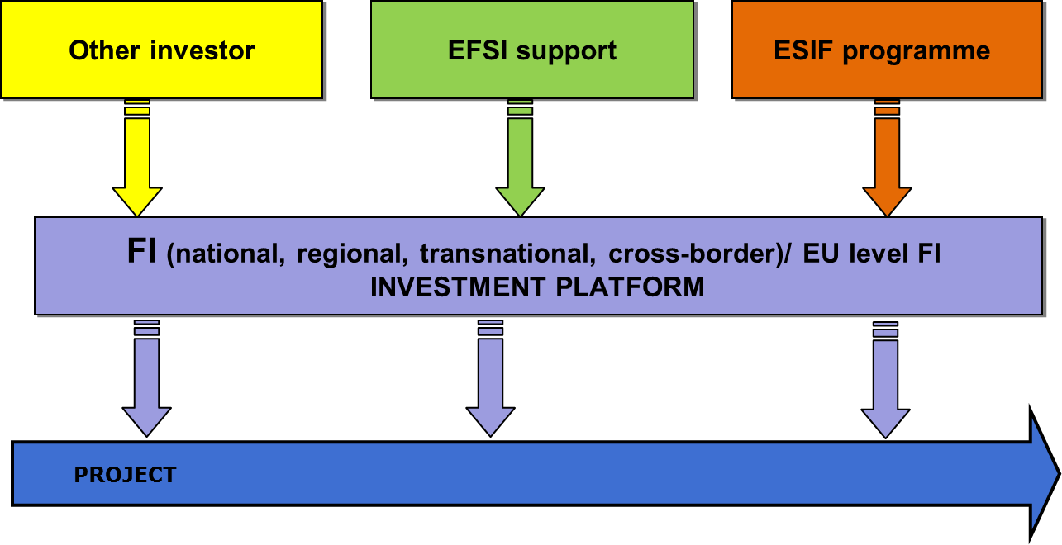
ESIF and EFSI combination –
Financial instrument/investment platform level
Notes:
In this type of combination ESI Funds programme and EFSI will meet at the level of Investment platform (which under CPR rules will be considered as a financial instrument).
Both support from EFSI and ESI funds programme takes the form of financial instrument product (e.g. equity). This combination type will not work with a grant from ESI funds!
Two main possibilities exist:
the managing authority may want to set up a new investment platform (considered as a financial instrument under CPR) in which EFSI and other investors would invest their resources. The investment platform would then invest EFSI and distinct ESI Funds programme contributions in projects (other investors may participate)
Another possibility is that the managing authority makes an ESI Funds programme contribution into an existing investment platform (considered as a financial instrument under CPR) which was set up with EFSI resources at national, regional, transnational or cross-border level. The investment platform would then invest EFSI and distinct ESI Funds programme contributions in projects (other investors may participate)

Slide 27
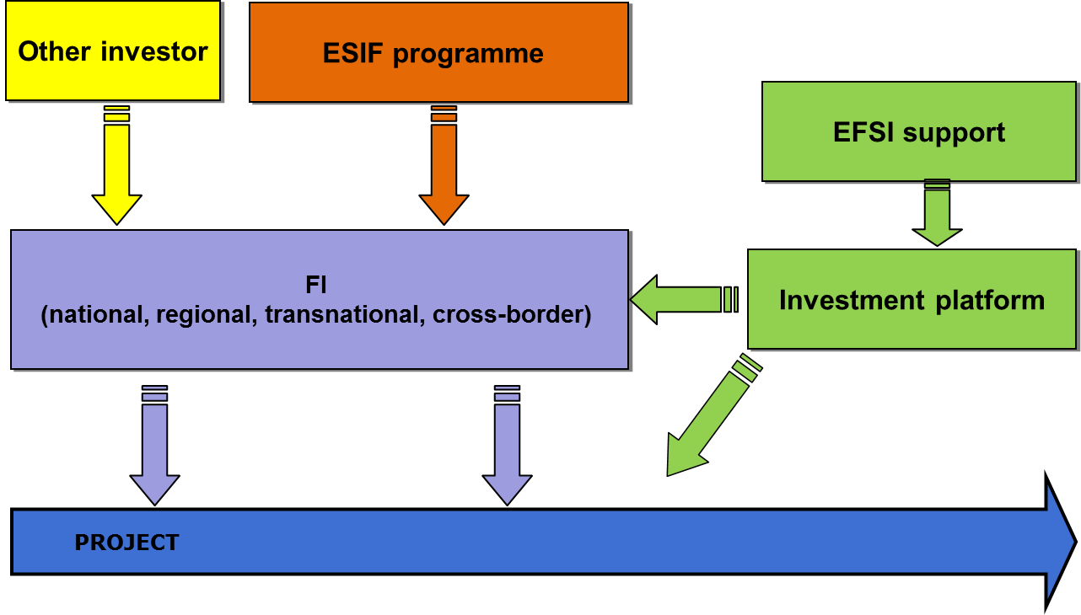
ESIF and EFSI combination –
Financial instrument/investment platform level
OR
Notes:
In this type of combination ESI Funds programme and EFSI channelled through an investment platform will meet at the level of financial instrument.
In this scenario, the managing authority sets up a financial instrument under CPR in which the investment platform (set up with EFSI support) participates as an investor. Other investors may also participate. The financial instrument would then invest EFSI and distinct ESI Funds programme contributions in projects (other investors may participate also at project level).
Another option would be an intervention by an investment platform (set up with EFSI support), directly at project level on a deal by deal basis.

Slide 28
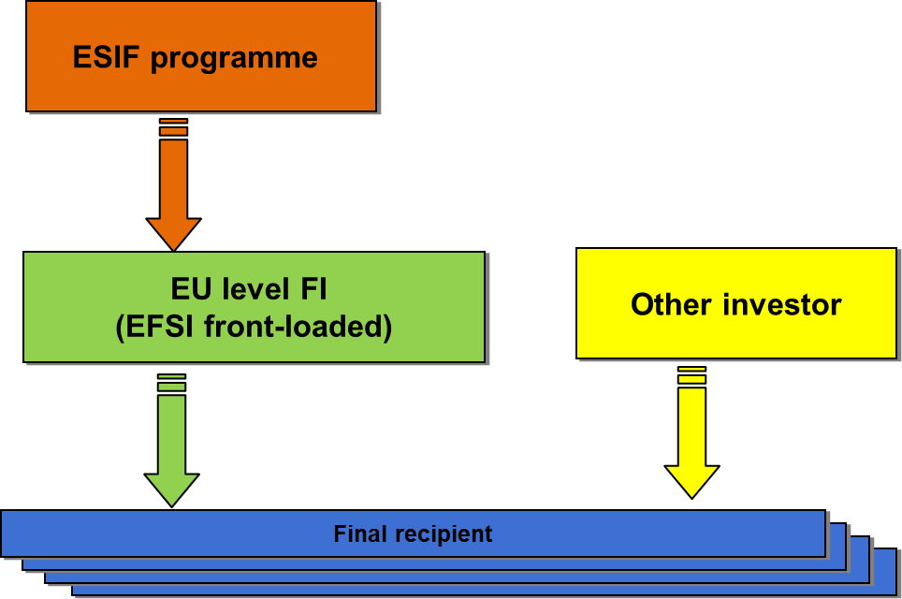
ESIF and EFSI combination –
SME products
Notes:
In this type of combination ESI Funds programme and EFSI would meet at EU level financial instrument.
EFSI contribution to EU level instrument took place. Under the SME window, COSME and H2020 available under the EU budget until 2020 were frontloaded thanks to the EFSI guarantee. In other words, the EFSI guarantee allowed to multiply the volume available under existing instruments in 2016 and hence to address much quicker the investment gap.
The CPR also allows for the possibility of ESI Funds contributing to (these and other) EU level instruments if this modus will address best the market gaps identified in the ex-ante assessment. This will require establishing compartments in the EU level instruments to ensure that earmarked ESI Funds comply with the geographic and policy criteria of the originating programme. (N.B. so far ESI Funds programme contribution did not take place)

Slide 29
2014-2020 Commission guidance for financial instruments
Short reference guide for managing authorities
Guidance notes
  complementary to short guidance
  covering all issues relevant to MA/fund managers
  developed systematically
  designed to be "living" documents (section on Q&A)
  so far five guidance notes finalised and published
Notes:
The idea was to develop comprehensive legislation and in this way avoid guidance notes.
The reality is different. COM receives significant number of questions in relation to FI
Single Framework for all ESIF implies also longer process of producing, consulting guidance

Slide 30
2014-2020 Commission guidance published
Glossary
The glossary contains for the moment only the basic definitions from the CPR and financial regulation in relation to financial instruments
The glossary will develop over time. It will be completed once all the guidance notes are prepared.
All the definitions and concepts developed in guidance notes will be added to the glossary

Slide 31
2014-2020 Commission guidance published
Ex-ante assessment
Objective: evidence based decision making
Requirement: legal obligation and tool to support implementation
Completion: before any programme contribution made to FI
Next steps: submission to the programme monitoring committee and publication
Process: raises awareness and ensures stronger ownership
Notes:
Needs to be completed before any programme contribution is made (i) for the setting up of a new FI or (ii) for an existing FI.
Can be carried out by the MA or be outsourced; can be financed from TA allocations.

Slide 32
2014-2020 Commission guidance
Working capital (1)
Support for working capital in enterprises is eligible as a mode of support to enterprises through financial instruments within certain conditions.
Working capital is explicitly mentioned in Article 37(4) CPR but firmly embedded in the context of CPR rules, fund specific conditions and State aid.
Eligibility of working capital is not generic (CPR provisions! Fund specific rules! ESIF programme conditions!)
Support of working capital and its eligibility will be more on a case by case basis.

Slide 33
2014-2020 Commission guidance published
Working capital (2)
Case by case assessment
ESIF support for working capital in enterprises, as for any investment financing to enterprises through financial instruments, is subject to compliance with two basic eligibility criteria: the types of enterprise and seven support targets under Article 37(4)
The fund manager will have to assess based on the business plan whether the investment proposed:
is potentially financially viable
the amount and proportion of working capital is justified in business and economic terms

Slide 34
2014-2020 Commission guidance published
Phased payments (1)
Main concepts:
ESIF programme contribution to financial instrument (ESIF contribution and national co-financing)
National co-financing at the level of FI operation
can be different than at PA level,
can be private/public,
can come at different levels: MA (e.g. regional budget), FoF (e.g. national resources), financial intermediary (e.g. own resources), or at the level of investment in final recipient (e.g. co-investment by business angel).
!!! Own contribution by final recipient does NOT count as national co-financing

Slide 35
2014-2020 Commission guidance published
Phased payments (2)
Main changes in relation 2007-2013 period:
phasing of max 25% of committed programme amount in FA paid,
  subsequent payments from Commission
  subject to implementation on the ground
  (60% second application, 85% subsequent applications)
flexibility for national co-financing
Applicability!
Formally MS –COM, but ..
NOT for "SME initiative" and "FI
directly managed by MA"

Slide 36
2014-2020 Commission guidance published
Combination (1)
Two types of combinations, as provided for in 2007-2013, continue. However, the legal framework in 2014-2020 contains explicit provisions - CPR 37(7)(8)(9)
The two types of combinations are envisaged also in Financial Regulation:
  Combination of a grant and a FI within a financial instrument operation
  Combination at the level of final recipient within two operations

Slide 37
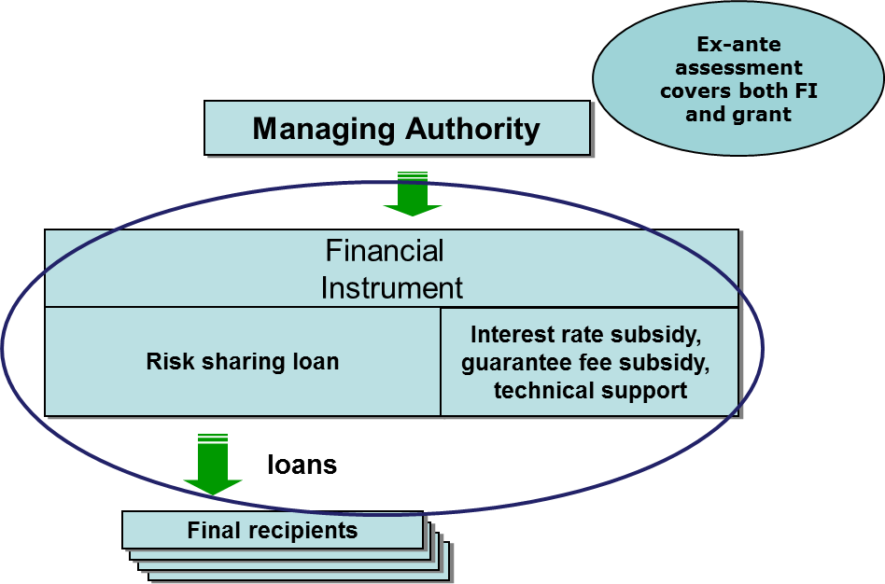
2014-2020 Commission guidance published Combination (2)
Combination of a grant and a FI within a financial instrument operation
Grant is directly related to financial instrument targeting the same final recipients (interest rate subsidy, guarantee fee subsidy, technical support). It is NOT a grant for the investment in final recipient.
Grant and financial instrument constitute a single operation, which falls under the provisions of Title IV and is financed from the same priority axis (and the same ESI Fund)
A contribution from MA to FI operation (covering both a FI and a grant) is justified and estimated in ex-ante assessment.
Compliance with State aid rules is needed.
For each form of support separate records have to be maintained.

Slide 38
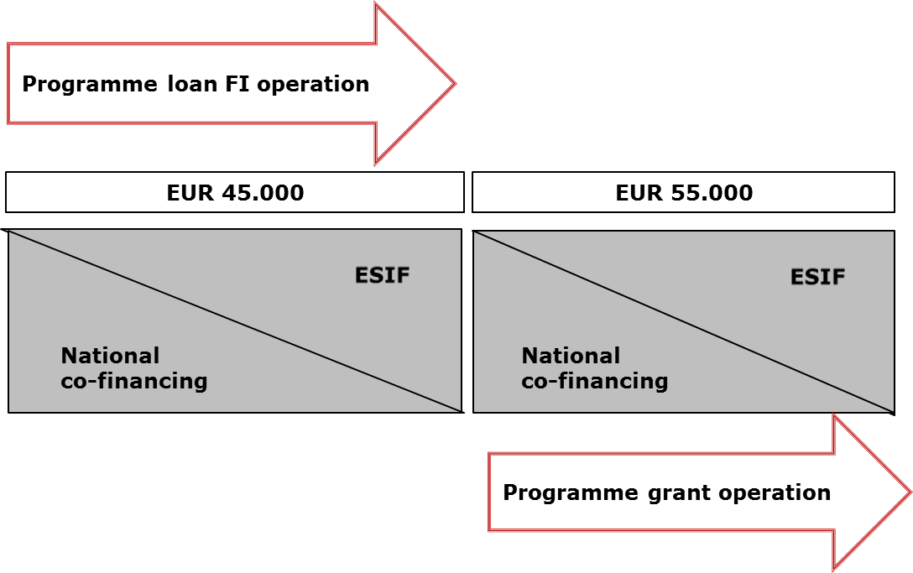
2014-2020 Commission guidance published
Combination (3)
Combination at the level of final recipient within two operations
Combination of support takes place at the level of final recipients ("beneficiary" in case of grants). The same body (enterprise) receives support from a grant and from a FI. Combination can cover the same investment or even the same expenditure item.
Combination results in two separate operations with distinct eligible expenditure.
The sum of all forms of support ≤ total amount of the expenditure item concerned.
State aid rules have to be respected (e.g. on cumulation, on own contribution free from state aid by the beneficiary in regional aid)
Grants cannot be used to reimburse support from FI.
FI cannot be used to pre-finance the grants.

Slide 39
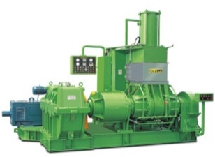



2014-2020 Commission guidance published
Combination (4)
Combination at the level of final recipient within two operations
Investment: 100
Investment: 100
co-financing rate at PA 50%
ESIF grant 100
ESIF loan 100
ESIF loan 45
ESIF grant 55
Grant, but received after investment
Loan of 100, paid back by the final recipient
Loan Operation
Grant Operation
1. Not allowed by the Regulation (see above)
2. Even if no over-financing with ESIF (because of the 50% co-financing rate) -double declaration of the same expenditure, and loan used to pre-finance a grant:
Eligible expenditure declared to EC:
- Grant: 100
- Loan: 100
Total ESIF reimbursement: (50% *100 +50%*100) 100
Eligible expenditure declared to EC:
- Grant: 55
- Loan: 45
Total ESIF reimbursement: (55*50% + 45*50%) 50

Slide 40
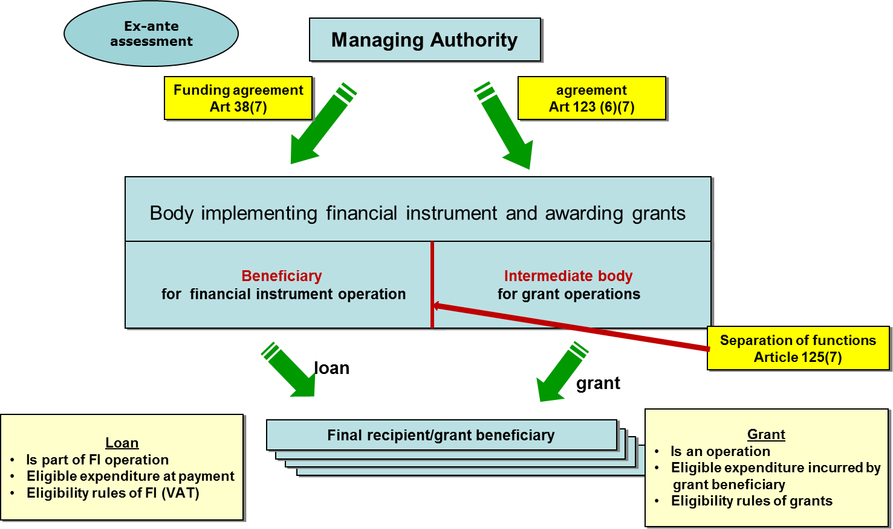
2014-2020 Commission guidance published
Combination (5)
Combination at the level of final recipient within two operations
In combination within two operations loan and grant can be given:
- by the same body (it will be "beneficiary" for FI and "intermediate body" in case of grant)
- to the same body (e.g. enterprise)- ("final recipient" for FI and "beneficiary" for grant)
- for the same project or even expenditure item (e.g. machinery)
!!! NOT for the same eligible expenditure (the same expenditure cannot be declared twice to COM) !!!

Slide 41
2014-2020 Commission guidance published
Management Costs and Fees/MCF (1)
Guidance Note under finalisation
2007-2013
MCF calculated on the basis of the amounts contributed to the FIs = decoupled from disbursements to final recipients AND rather high limits
2014-2020
- requirement for performance orientation
- new calculation of thresholds

Slide 42
2014-2020 Commission guidance published
Management Costs and Fees/MCF (2)
Eligibility period
Formal selection
  eligibility period for MCF
  Exceptions: equity-based instruments
  and micro-credit
Preparatory works
Signature of the funding agreement
END
31 Dec 2023
MCF<= thresholds

Slide 43
2014-2020 Commission guidance published
Management Costs and Fees/MCF (3)
Eligible MCF
At closure, they should not exceed the amount calculated in accordance with CDR Art. 13 which is a sum of:
base remuneration (the basis is programme contribution to FI, the investments in final recipients are not relevant here)
performance remuneration (the basis are investments in final recipients)
Different calculation of thresholds in function of the implementation options (fund of funds or a specific fund) and type of instrument
The amount calculated under point 1 is to be capped by a general threshold on the entire programme contribution

Slide 44
2014-2020 Commission guidance published
Management Costs and Fees/MCF (4)
Body implementing… | General –cap rate- Thresholds Art 13(3) CDR | Implementation progress; Art 13(1) and (2) CDR
 |  | Base remuneration: rates p.a./pro rata temporis | Performance remuneration: rates p.a./pro rata temporis
Fund of Funds | 7.00% | For first 12 months* 3.00% | 0.50%
 |  | For next 12 months* 1.00% | 0.50%
 |  | Following years 0.50% | 0.50%
Loans | 8.00% | 0.50% | 1.00%
Guarantees | 10.00% | 0.50% | 1.50%***
Equity | 20.00% | For first 24 months* 2.50%** | 2.50%
 |  | Following years 1.00%** | 2.50%
Micro credit | 10.00% | 0.50% | 1.50%
Other | 6.00% | 0.50% | 0.50%

Slide 45
2014-2020 Commission guidance published
Management Costs and Fees/MCF (5)
Eligible MCF
The methodology of calculation eligible MCF does not apply if:
The body implementing the financial instrument is selected through a competitive tender which proves the need for higher MCF, or
For equity where the majority of the capital invested in financial intermediaries is provided by private investors or public investors operating under market economy principle and the programme contribution is provided pari passu with the private investors
Higher MCF can be paid from non-ESIF resources, e.g. from resources attributable to the support from ESI Funds programmes which are paid back from investments in final recipients, or from own resources (but state aid rules apply)

Slide 46
2014-2020 Commission guidance published
Management Costs and Fees/MCF (6)
Article 12(2) CDR: the managing authority shall inform the monitoring committee about the performance-based calculation of management costs and fees of the financial instruments (the Commission recommends that the monitoring committee is informed before the relevant funding agreements are signed as it was good practice in some cases in the 2007-2013 already). The monitoring committee shall also receive reports on an annual basis on the management costs and fees effectively paid in the preceding calendar year.
Article 46(2)(e) CPR: the specific report on financial instruments shall include the information about the management costs incurred or management fees paid, by each financial instrument and by programme and priority or measure.

Slide 47
Commission Guidance published
Reporting in 2014-2020
Article 46 of CPR
First summary report on progress of implementation FI in 2016
Deadline for report: AIR deadline (31 May / 30 June) + 6 months
⇒ Time to review and correct data in parallel to AIR process
Report on FI as annex to AIR
Model for reporting on FI in Implementing Regulation (EU) No 821/2014 – Annex I
Additional information compared to current reporting in the areas of:
Management costs and fees, reflows and follow on investment, default of loans and guarantees,
leverage and output indicators (only in 2017,2019 and final report)
Notes:
Model for reporting on FI
Implementing Regulation (EU) No 821/2014 – Annex I
New:
Obligatory information will become compulsory
More information on "other financial instruments" and subsidy schemes
Information on setting up FI (ex-ante, selection procedures)
More details on management costs and fees
Reflows and follow on investment
Default of loans and guarantees
Leverage (only in 2017, 2019 and final report)
Output indicators (only in 2017, 2019 and final report)

Slide 48
2014-2020 Commission guidance in the pipeline
Forthcoming guidance documents
Already presented to Member States – under publication
Selection of bodies implementing FIs
Preferential remuneration of private investor
Treasury management
In preparation
State aid
Eligibility
Implementation options
Reporting on FI

Slide 49
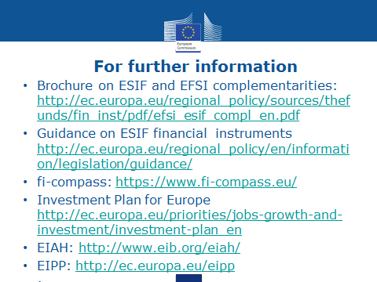

Slide 50
Thank you for your attention
Q&A

