Slide 1
take part in the European
energy revolution
Henrique Burnay
EUPPORTUNITY
AGORADA 2016
Brussels, 27th May 2016

Slide 2
What is the Citizenergy project?

Slide 3
14 EUROPEAN PARTNERS:
RES promoters & initiatives,
financial & legal experts,
NGOs & development agencies
“...to boost effective citizen engagement
and investment in sustainable energy„

Slide 4
More citizen investment
Not enough people reached
Investment pace too slow
Campaign not convincing
Investors not allowed to invest

Slide 5
A platform to help:
citizens identify investment opportunities in renewable energy in any part of Europe
crowdfunding platforms and community projects build trust and reach a larger audience
project developers fund their projects faster
Our vision:
“the tripdavisor.com of community energy”
www.citizenergy.eu

Slide 6
what we do?
the first European portal to bring together REcrowdfunding platforms and Renewable Energy cooperatives
from across Europe

Slide 7
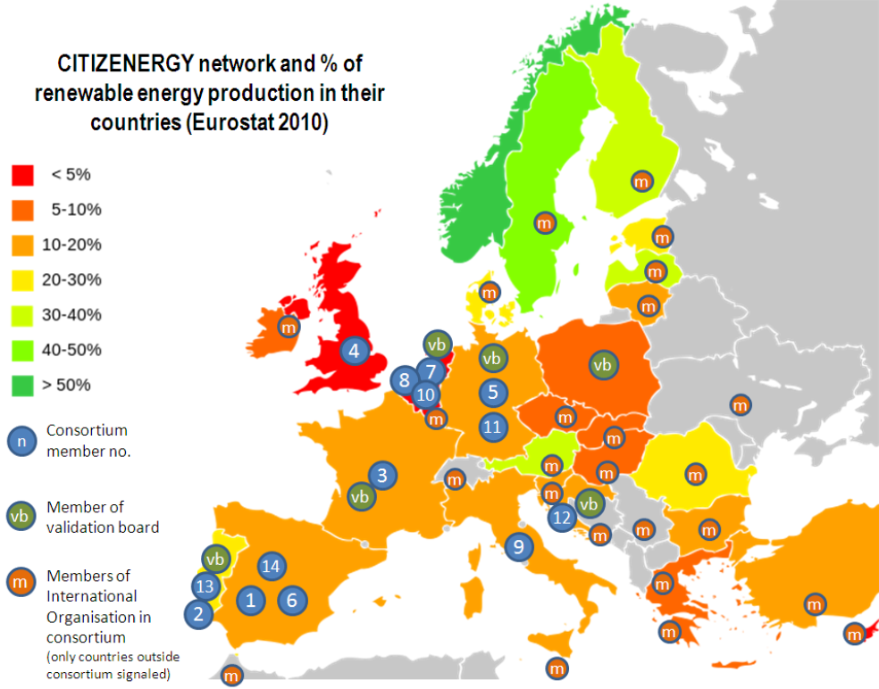
EU wide!
82 development agencies
1723 cities (+Covenant)
+3000 RESCoops
+600k citizen RESinvestors
+1M citizen NGO members

Slide 8
Eupportunity is a consulting company specialized in EU affairs providing services on three main domains:
Public Affairs (comprising intelligence, risk analysis, profile raising and representation & advocacy)
European Funding Programs (scanning of funding opportunities and support to applications)
Internationalization (business opportunities emerging from the implementation of European Funds at EU institutions and third countries levels)

Slide 9
EUPPORTUNITY’ ROLE IN CITIZENERGY
FINANCIAL COORDINATOR
REPORT ON LEGAL BARRIERS TO CITIZEN INVESTMENT IN RENEWABLE ENERGY PROJECTS

Slide 10
CROWDFUNDING - LEGAL BARRIERS
Innovative project financing, new problems to solve:
No clear legal framework in the EU;
Member States are now setting up national legal frameworks for crowdfunding;
Lack of transparancy and legal uncertainty for cross boder investment due to the variety of national regulatory systems;
Uneven playing field in taxation

Slide 11
WHAT‘S NEXT?
European Network expansion
Developing long-term sustainable business model
Creation of a European Network of stakeholders

Slide 12
What’s next?
✓
growing network
2
platform integration
3
project
aggregator
direct
investment
one stop
shop

Slide 13
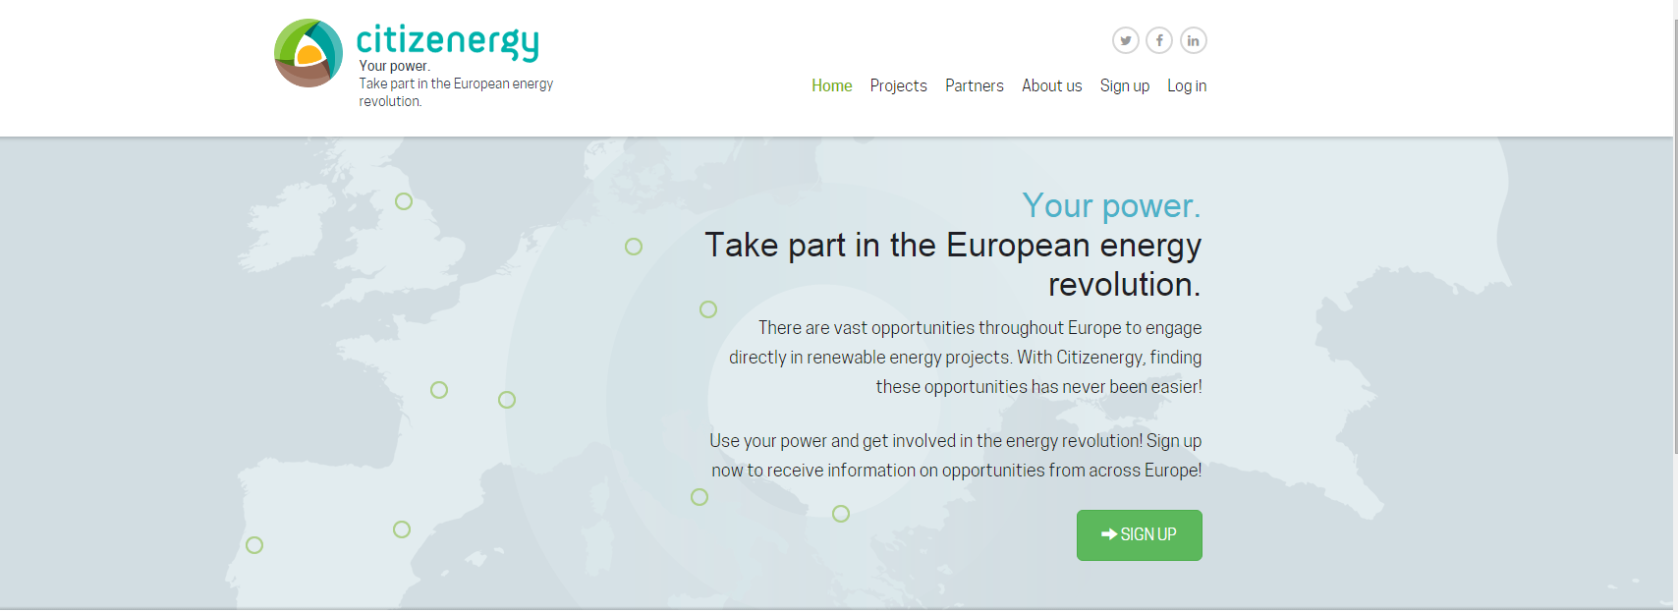
where we stand

Slide 14
HOW TO GET INVOLVED
Visit us on Citizenergy.eu
Join us on social networks
Subscribe to our newsletter
Spread the word about Citizenergy

Slide 15
THANK YOU FOR YOUR ATTENTION!
Henrique Burnay
hburnay@eupportunity.eu
The sole responsibility for the content of this slides lies with the authors. It does not necessarily reflect the opinion of the European Union. Neither the EASME nor the European Commission are responsible for any use that may be made of the information contained therein.

