Slide 1
Learning from practice: case studies
Bpifrance’s experience with InnovFin
26/05/2016

Slide 2
01.
Bpifrance in short
02.
Implemention of InnovFin
03.
Proposals to improve InnovFin

Slide 3
01.
Bpifrance in short

Slide 4
Bpifrance in short
2,540 employees
43 regional offices
A public-sector bank
A full-service bank supervised by the ECB
The French Export Credit Agency (ECA)
A bank respected by the markets: financed at French TB rate + 14 bp
8 business lines
Loan Guarantees
Public Export Insurance
Loans
Innovation
Fund of funds
Small cap investment
Mid/large cap investment
Business Support
2 subsidiaries
Bpifrance Financement
Bpifrance Investissment
One of the first EU investment company for start-ups, SMEs , Mid & large Caps
EUR 24,6 billion under management
380 professional staff
90%
decentralised decisions at regional level

Slide 5
Over €24 Bn mobilized by Bpifrance in 2015
€7.5 Bn of short term loans
€4.1 Bn of classic loans & co-financing
€2 Bn of development lending
€1.3 Bn of innovation financing
€14.9 Bn
of financing
€3.7 Bn risks taken*
*Partner Banks’ loans are partially guaranteed from 40% up to 70%, with the support of most French Regions
€8.6 Bn
of guaranteed loans
€169 M directly invested in venture capital
€132 M directly invested in SMEs
€777 M directly invested in Midcaps and big companies €685 M subscribed into partner funds
€1.8 Bn
of equity

Slide 6
02.
Implementation of InnovFin

Slide 7
Implementation of InnovFin
Bpifrance’s InnovFin Agreement
02.
1st transaction approved by EIF under the Juncker plan in May 2015
Supported through the SME window of the IPE (frontloading procedure)
A portfolio of EUR 420m of loans to innovative SMEs and Small Midcaps guaranteed by EIF
Guarantee covering two recent products:
The EIF Innovation Loan (EUR 320m)
The EIF Seed Investment Loan (EUR 100m)

Slide 8
Implementation of InnovFin
Innovation products before EU support
02.
Amount
Risk level
Investments
5M€
Growth Loan
3M€
AR / PTZI
Sales
500k€
GRANT
Formulation
Feasibility
Launching & growth
time
Development
Pre-launching

Slide 9
Implementation of InnovFin
With EU support (RSI & InnovFin)
02.
Amount
Risk level
Investments
5M€
Growth Loan
3M€
AR / PTZI
Innovation loan
Sales
500k€
Seed
Loan
GRANT
Formulation
Feasibility
Launching & growth
time
Development
Pre-launching

Slide 10
Implementation of InnovFin
Bpifrance’s Innovation Loan
02.
The EIF Innovation Loan:
Launch: February 2014 under the Risk Sharing Initiative (RSI)
Beneficiaries : SMEs and Small Midcaps up to 500 employees (only SMEs under the RSI before 2015)
Aim: to finance intangible investments and WCR related to the industrial launch and commercialization of innovation.
Amount : up to EUR 5m (EUR 3m under RSI)
Very attractive conditions : no collateral required, 2 years grace period
Portfolio : EUR 320bn with 50% Guarantee of EIF

Slide 11
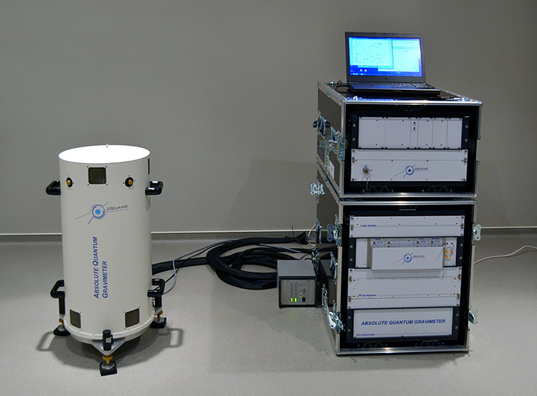
Implementation of InnovFin
Examples of EIF Innovation Loans
02.
MUQUANS proposes a new generation of ultra-high performance measurement instruments based on a unique and patented technology, which relies on the utilization of laser cooling, trapping and manipulation of neutral atoms.
Localisation : Talence (Aquitaine)
Creation : 2011 by 3 PhDs in quantum physics (a spin-off from Institut d’Optique de Paris)
Staff : 15
First round with 3 VC in 2014 : EUR 1,7m raised
Needed financing to accelerate commercialization, consolidate technology and boost export

Slide 12
Implementation of InnovFin
Examples of EIF Innovation Loans
02.
DEVISUBOX has developed innovative wireless photo webcams specialized to construction site monitoring. Commercialization started in 2013.
Needed finance for : starting to export – targeted markets : US, Germany, Emirates
Localisation : Marseille
Turnover : ~2M€
Staff : 24
Eligibility criteria:
Has been awarded grants, loans or guarantees from an European or national R&I support scheme
Loan Amount:
EUR 1 500 000

Slide 13
Implementation of InnovFin
Examples of EIF Innovation Loans
02.
Provepharm is a French pharmaceutical company dedicating in the development and valorization of Drug Products world wide
Needed finance for : clinical studies required by the FDA to get a marketing authorization on the US market
Localisation : Marseille
Turnover : ~5M€
Staff : 12
Eligibility criteria:
R&I costs represent at least 10% of its total operating costs
Loan Amount:
EUR 2 000 000

Slide 14
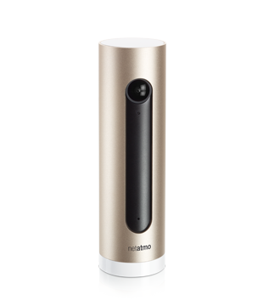
Implementation of InnovFin
Examples of EIF Innovation Loans
02.
NETATMO is specialized in connected objects and intelligent systems (Home camera with face recognition, weather station for smartphone etc.)
Needed finance for : developing new commercialization channels and
investing in R&D in order to keep a competitive edge
Localisation : Boulogne
Turnover : ~12M€
Staff : 46
Eligibility criteria:
Has been awarded grants, loans or guarantees from an European or national R&I support scheme
Loan Amount:
EUR 2 000 000

Slide 15
Implementation of InnovFin
Bpifrance’s EIF seed investment loan
02.
The EIF seed investment loan
Launch: 2015 under InnovFin
Beneficiaries : innovative start-ups of less than 5 years which access to new equity funds from investors (BA, VC funds etc.)
Eligible costs: tangible and intangible investments
Aim: to help innovative start-ups in the negotiation of their valorization with identified investors (Loan concomitant to the fund raising)
Amount: up to EUR 500k€ (1€ of debt for 2€ in equity received)
Attractive conditions : 8 years with a 3 years grace perdiod
Portfolio: EUR 100m with a 40% EIF Guarantee

Slide 16
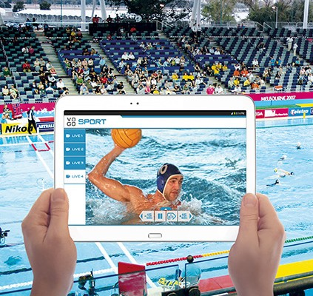
Implementation of InnovFin
Examples of EIF Seed Investment Loans
02.
VOGO develops and commercializes a very innovative video solution on mobile devices for sport event spectators (live access to different video cameras, slow motion, rewind etc.)
Partnership with BeIN Sport
Raised EUR 4m in 2014 (from founders, VC, Languedoc Region)
Needed financing to accelerate international expansion : office in Montreal in 2015, then Japan.
Localisation : Montpellier (Languedoc)
Creation : 2013
Staff : 6

Slide 17
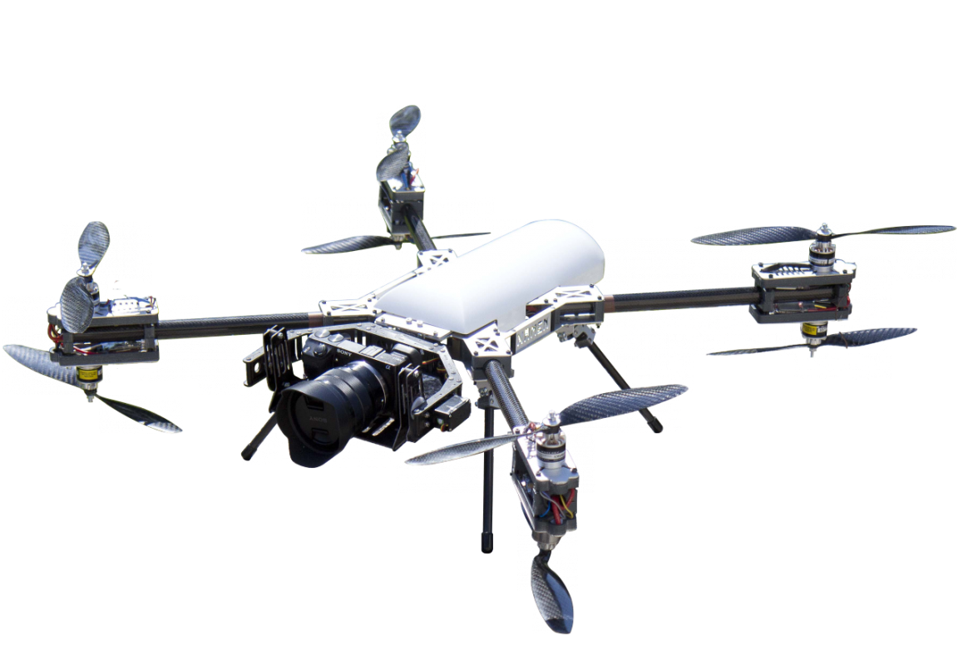
Implementation of InnovFin
Examples of EIF Seed Investment Loans
02.
XAMEN TECHNOLOGIES designs and develops and commercialize unmanned aircrafts (drones) for civil uses (security of industrial plants, aid after natural disaster, environment protection etc.).
Needed finance to: speed up commercialization
Raised EUR 1,3m in 2015
Localisation : Pau (Aquitaine)
Creation : 2012
Staff : 10

Slide 18
Implementation of InnovFin
Two very successful products
02.
As at February 2016 (after only 8 months), Bpifrance had provided:
EUR 200m (PI FEI product) = 62% of the portfolio
EUR 50m (PAi Start-up product) = 50% of the portfolio
Thanks to InnovFin, Bpifrance has already supported more than 700 innovative companies (Target = 1245 companies).
Bpifrance is currently applying for an increase of its InnovFin portfolio to continue financing innovative SMEs & small Mid-caps at favorable conditions.
An additional 1790 companies are expected to be included in the InnovFin portfolio following this increase.

Slide 19
03.
Proposals to improve InnovFin

Slide 20
Proposals to improve InnovFin
Bpifrance’s proposals
03.
Process innovation should clearly be acknowledged as a key dimension of innovation supported through InnovFin. Any loan financing an investment in process innovation should therefore be eligible by nature to InnovFin.
Additional resources on InnovFin for after 2017
Reporting requirements and fee structure of InnovFin Midcap (MCG- EIB) should be better aligned to InnovFin SMEG.
New uncapped Guarantee for Unsecured Loans to RDI-intensive SMEs and Small Mid-caps – this addresses a clear market gap

Slide 21
SERVING
THE FUTURE

